Slide 1
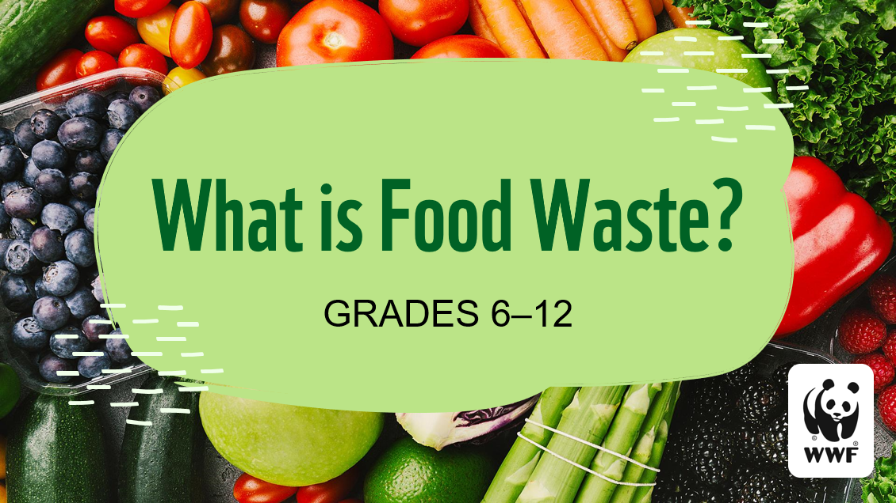

Slide 2
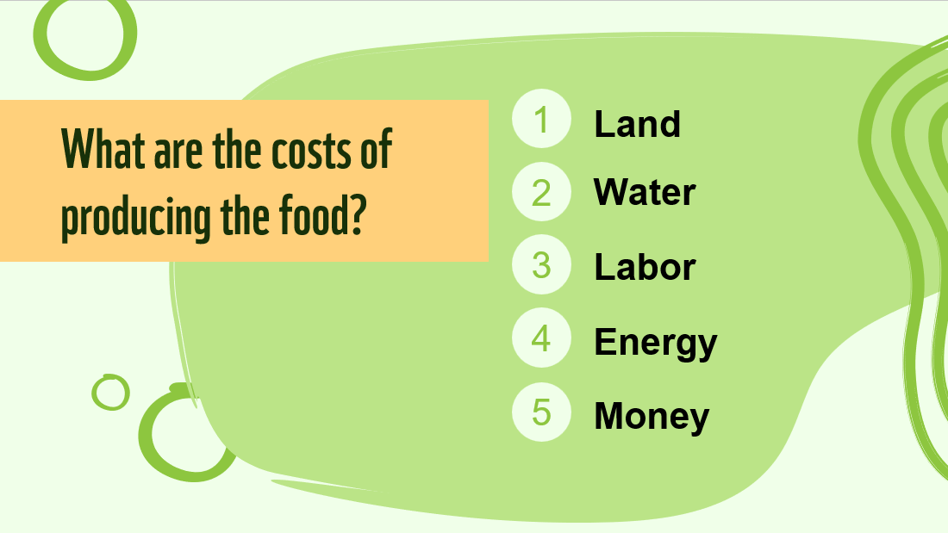
Notes:
Food comes at a cost. Have you ever thought about what goes into producing the food that ends up on your plate?

Slide 3
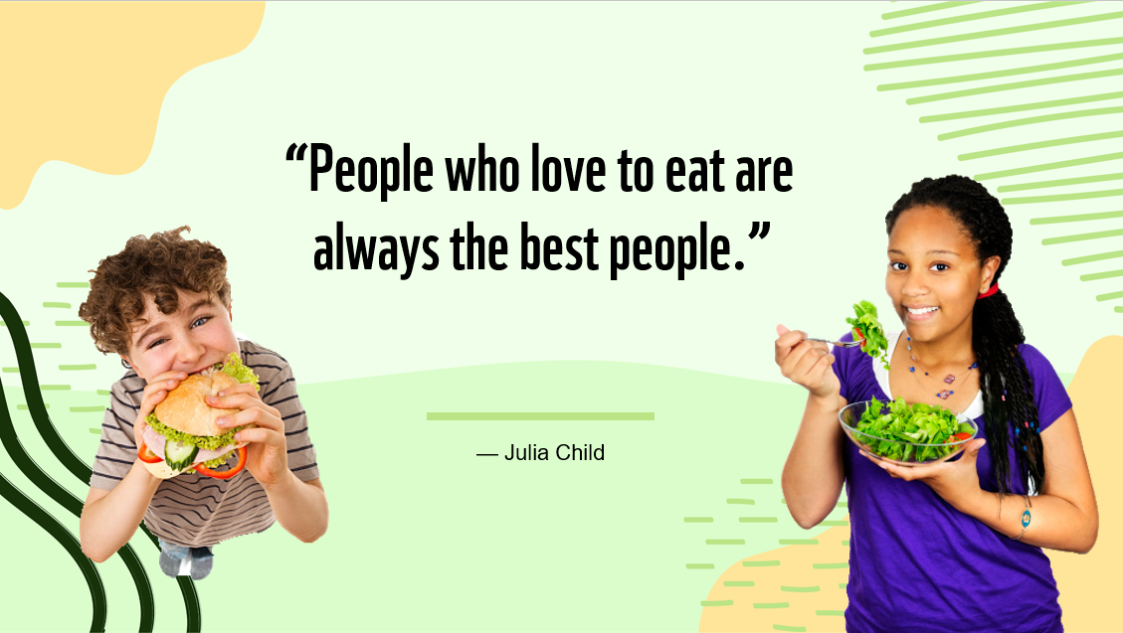
Notes:
Food. It’s something we all think about daily, and it can be one of life’s greatest pleasures. (Ask several students to describe their favorite meal, favorite snack, and/or favorite dessert.)

Slide 4
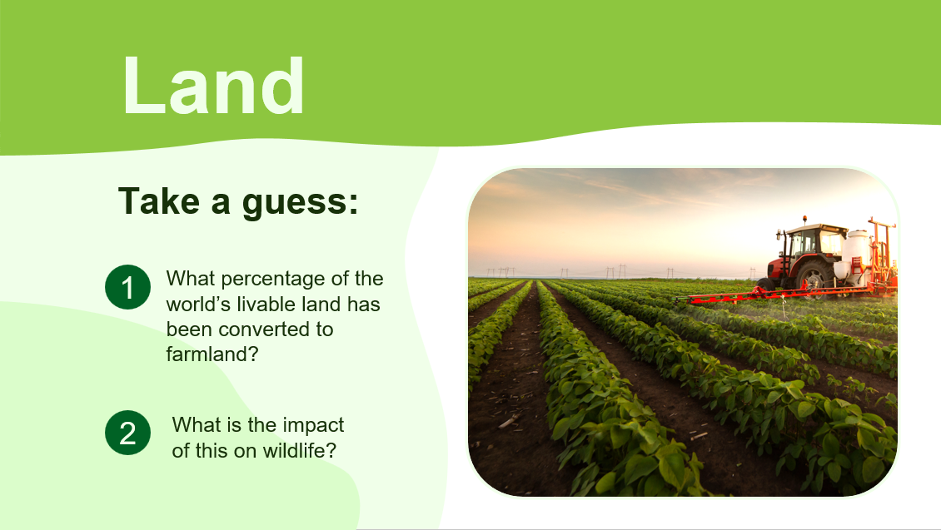
Notes:
We are going to talk about two of those today: land and water. Let’s start with land. Here are two questions.
The answer to the first one is that 50% of the world’s livable land has been converted to farmland.
The answer to the second question is: it’s huge!

Slide 5
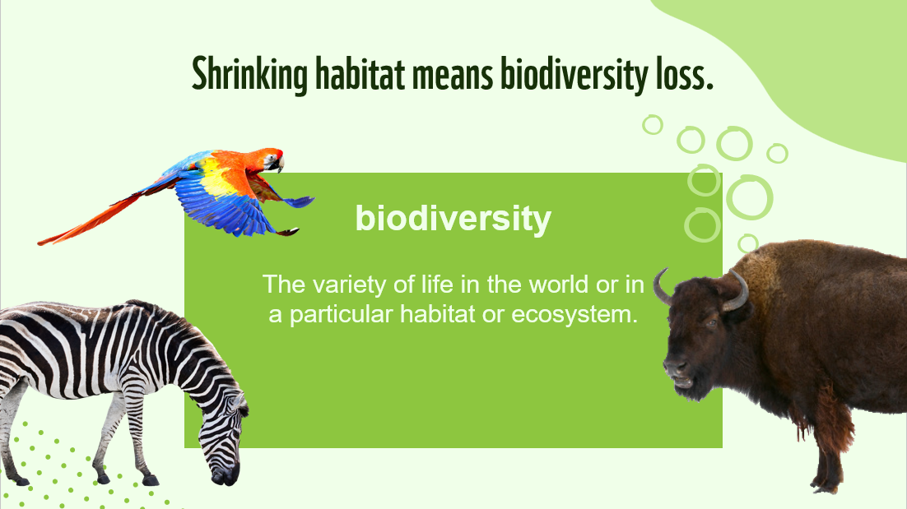
Notes:
“Biodiversity loss” sounds like a complicated term, but its meaning is simple. It refers to the extinction or reduction of animal species. It means that as people use more of the earth’s land, the number and variety of animals that can survive shrinks. What does this have to do with food? Well, 70% of biodiversity loss is due to food production. As we produce the food necessary to feed the world, we sacrifice the wildlife that makes our planet such an incredible place.

Slide 6
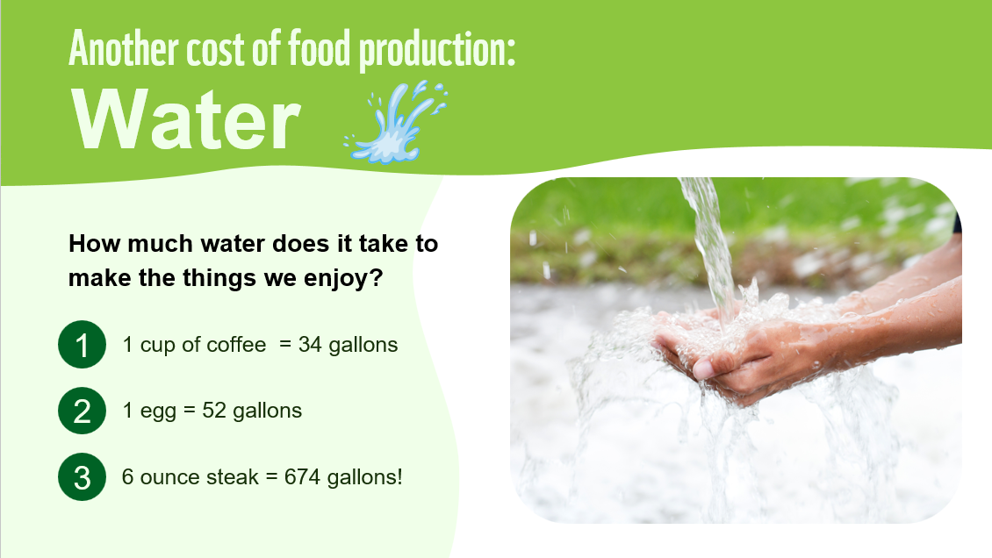
Notes:
Back to the costs of food production. Another major part of what is needed to produce food is water. Crops need water to grow. Animals need water to drink. The amount needed is staggering! (Reveal each bullet point as you talk about it.) That’s a lot of water. In fact, 80-90% of U.S. water consumption is for agriculture.

Slide 7
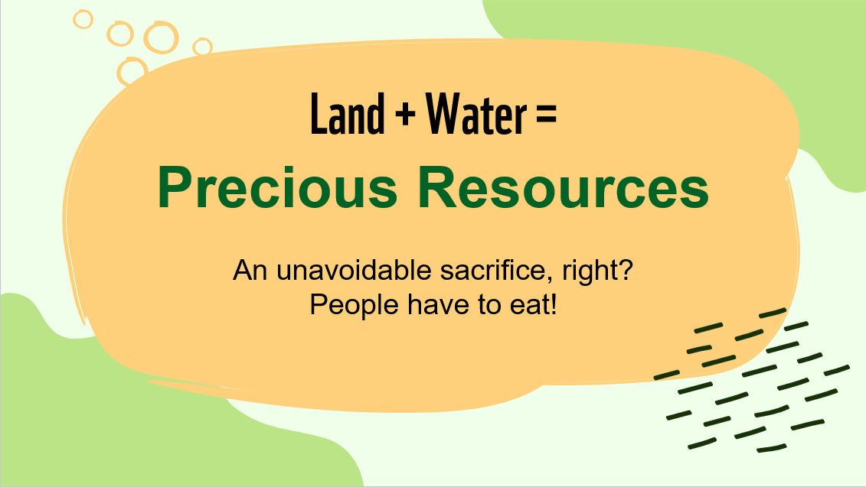
Notes:
So the point is, we use a LOT of land for growing and raising food. And we use a LOT of water for the same thing. But it’s worth it, right? We have to feed people … there is no getting around it! Well, right … and wrong. How much food do you think we actually consume, and how much do you think is wasted? (Allow students to hypothesize.)

Slide 8
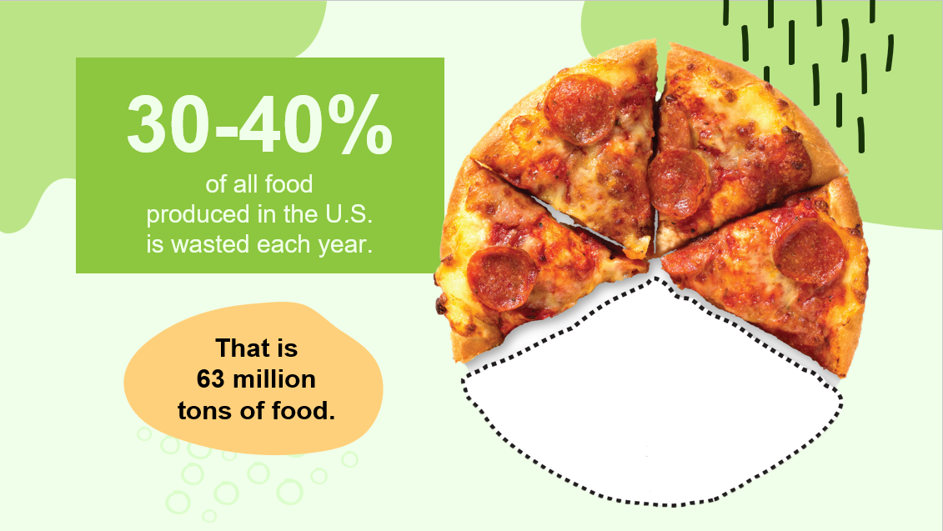
Notes:
Imagine that your mom or dad made you a birthday cake, and before eating it, you sliced off a third of it and dumped it in the trash. It sounds crazy, but that’s exactly what we do in the United States. A third of all the land and water used for food, a third of the labor invested in growing it, a third of the fuel used to plant, harvest, and transport it—is for nothing. Sometimes it’s hard to grasp what numbers like this actually mean, so let’s look at some illustrations…

Slide 9
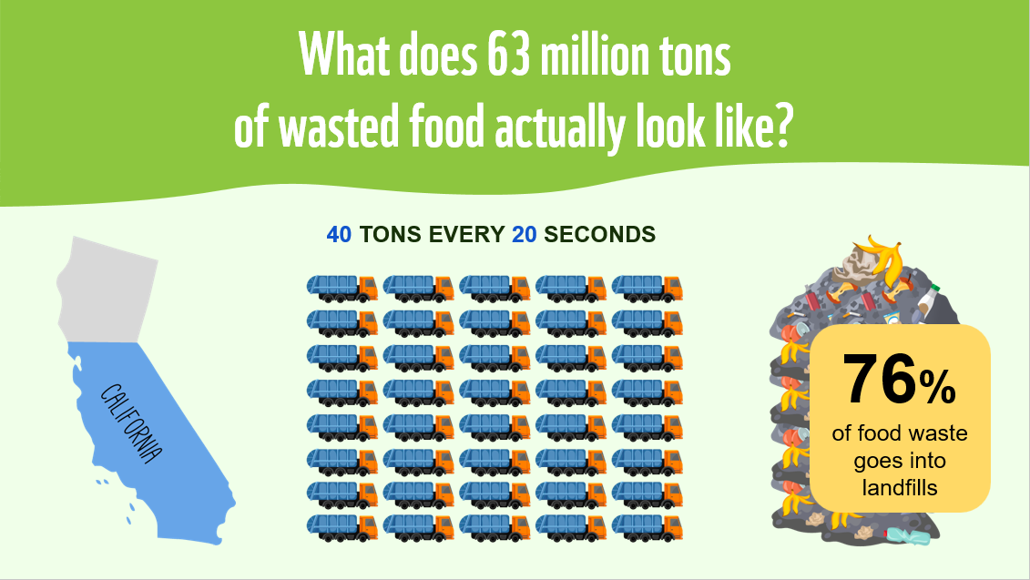
Notes:
If all the food we wasted came from one farm, that farm would be three quarters the size of California. It would harvest enough food to fill a 40-ton tractor-trailer every 20 seconds. Picture a tractor-trailer full of food, dumping its contents in a landfill every 20 seconds, all day and all night. That’s the situation in our country.

Slide 10
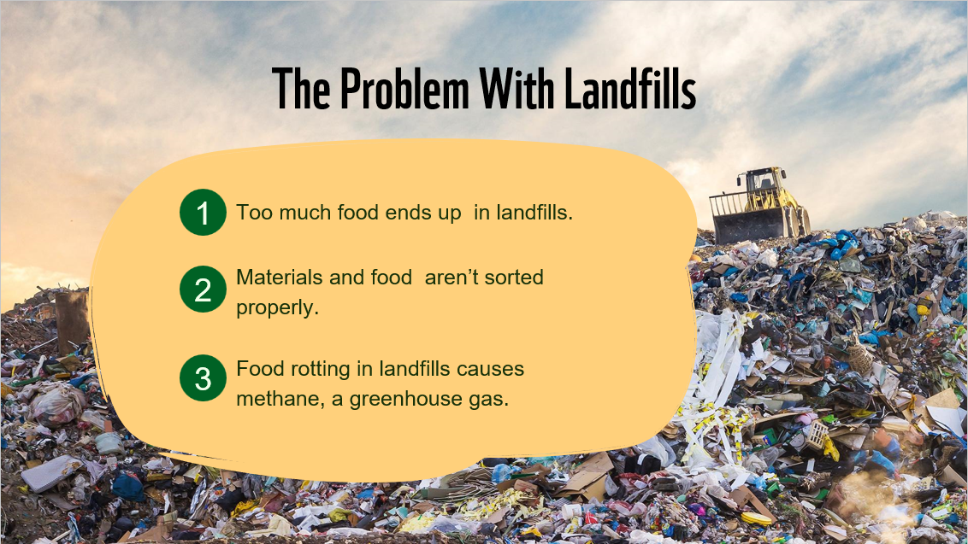
Notes:
We need SOME greenhouse gases … they keep our planet warm enough to live on. But too much is bad because this causes climate change, extreme weather events, and the sea levels to rise.
There are different kinds of greenhouse gases. Composting produces one greenhouse gas called carbon dioxide. When food waste is composted, it is digested by bacteria with oxygen, releasing carbon dioxide. When food is put in landfills, it is digested by bacteria without oxygen, releasing methane, a greenhouse gas that can heat our planet 25 to 30 times more powerfully than carbon dioxide. That’s why compost is better than landfill: because it produces the kind of gas that warms our planet less.
Agriculture is the world’s second-largest emitter of greenhouse gases. In the U.S., food in landfills produces 124 million tons of greenhouse gas emissions, which is enough energy to power 13 million homes for one year!

Slide 11
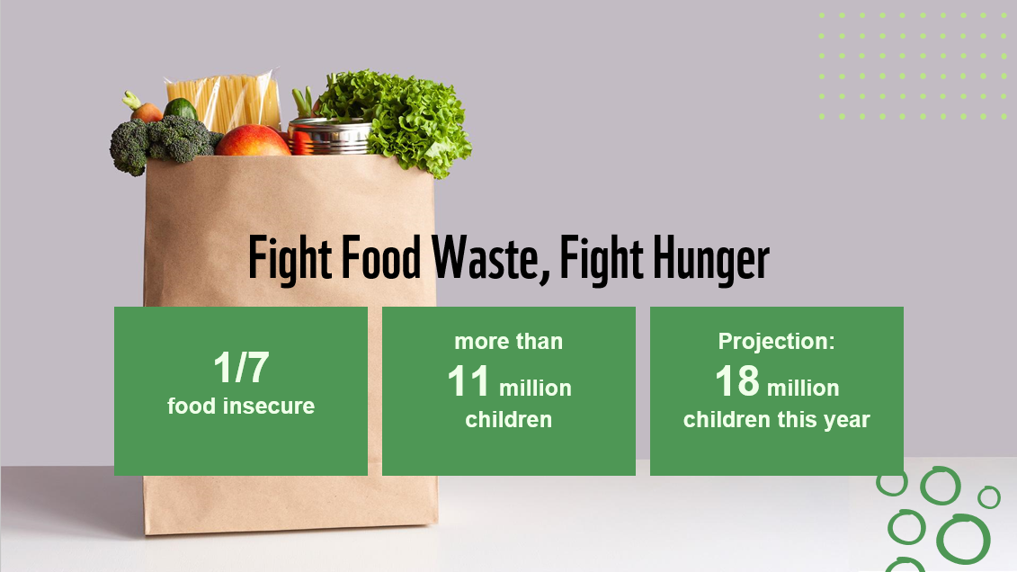
Notes:
With so much food waste, there should be no hunger, right? We have so much to spare! Unfortunately, while 30-40% of food goes to waste, filling up our landfills and warming the atmosphere, one out of seven Americans lives in a “food insecure” household. The USDA defines food insecurity as a lack of consistent access to enough food for an active, healthy life. More than 11 million of those facing food insecurity are children. And because of the coronavirus pandemic, projections show that 18 million children could face hunger this year.

Slide 12
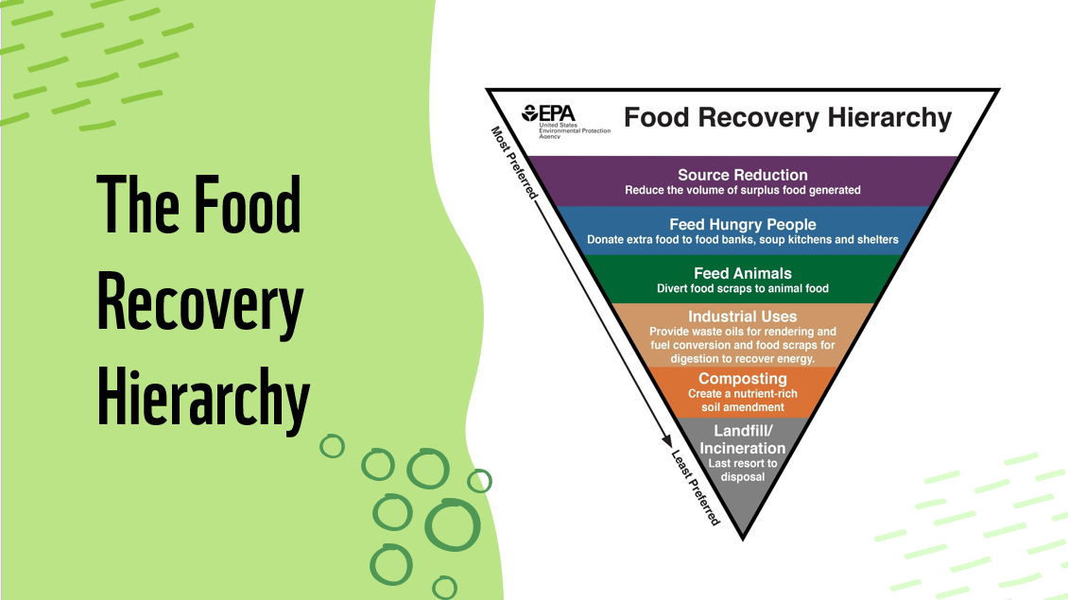
Notes:
The food recovery hierarchy is a tool developed by the EPA (Environmental Protection Agency) to illustrate the priorities we should have when fighting food waste. The top of the triangle represents the strategies that are most preferred, down to the least preferred at the bottom. Use the triangle as you talk about how to solve food waste issues on the next few slides. Consider new ideas like food scraps for animals and using oils for fuel.

Slide 13
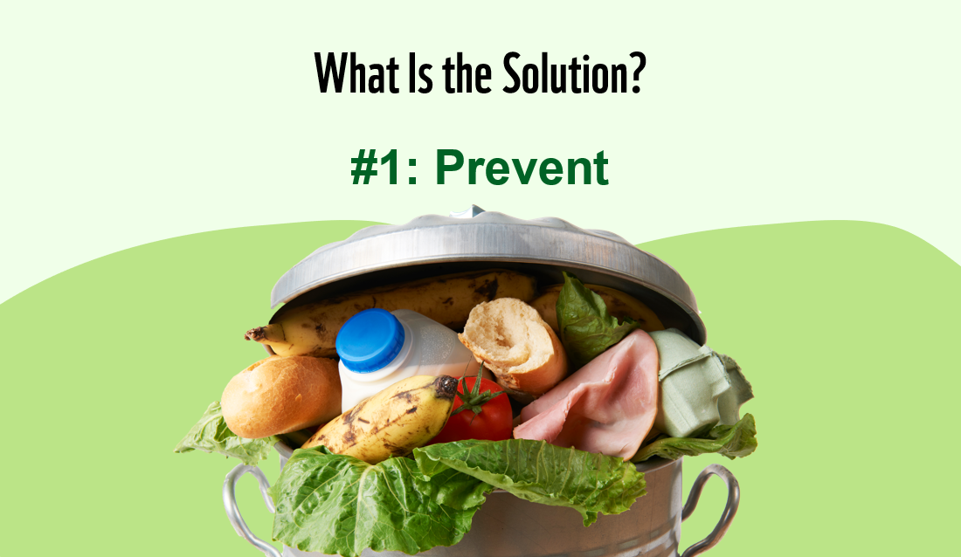
Notes:
The impact of all of this wasted food on our environment is huge, and the fact that we still have so many going hungry is hard to understand. When we think about food waste and how to solve this problem, the most important priority is to prevent food waste from happening in the first place. How can we do this?

Slide 14
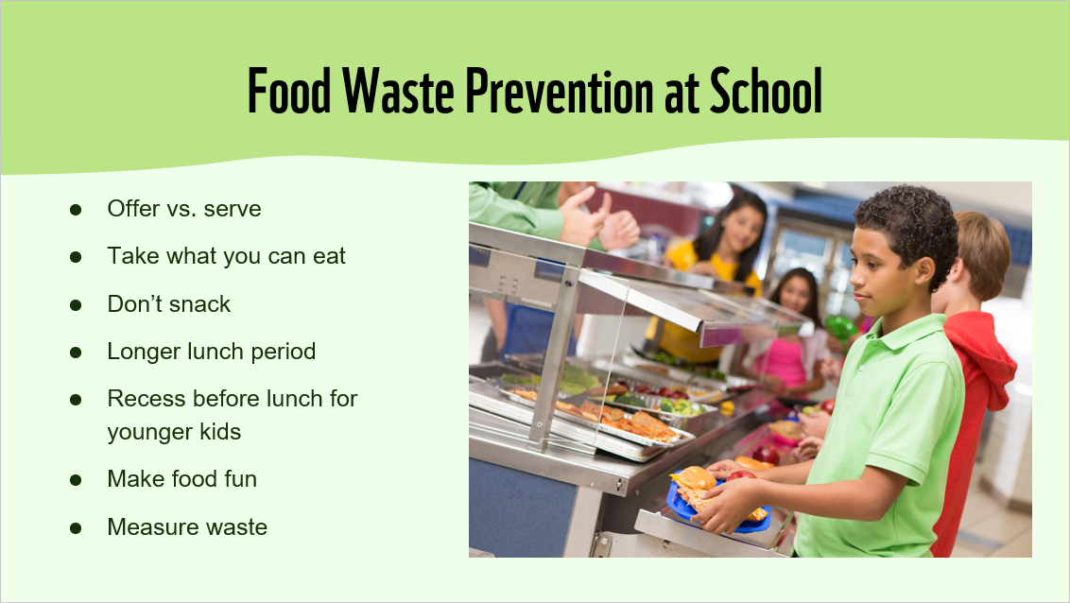
Notes:
Let’s first talk about how we can prevent food waste in schools. The following is a list of strategies. (After going through the list, you can have students weigh in on which strategies they think would be most effective.)
Offer vs. serve is a concept that applies to school menu planning and meal service that allows students to decline some of the food offered in a reimbursable lunch or breakfast. It is optional in elementary and middle schools, mandatory in high schools.
Students should be encouraged to only take what they are hungry for. Just because it’s there doesn’t mean you have to take it!
Snacking less means you’re hungry for your meals and more likely to finish them.
In one study by the Harvard School of Public Health, schools that gave students more time to eat had 13% less entree waste, 12% less vegetable waste, and 10% less milk waste.
In one study by the Smarter Lunchrooms Movement, schools that scheduled recess before lunch reduced food waste by 40%.
In another study by the Smarter Lunchrooms Movement, schools that called their carrots “X-Ray Vision Carrots” doubled their consumption. Slicing apples also resulted in a 73% increase in the number of students who ate more than half of their apple. Other ways to make food fun include taste tests and recipe competitions.
By doing food waste audits regularly, we can see which food is wasted most often and why and show the results to cafeteria managers so they can make smarter decisions about which food to serve. We will learn more about that later!

Slide 15
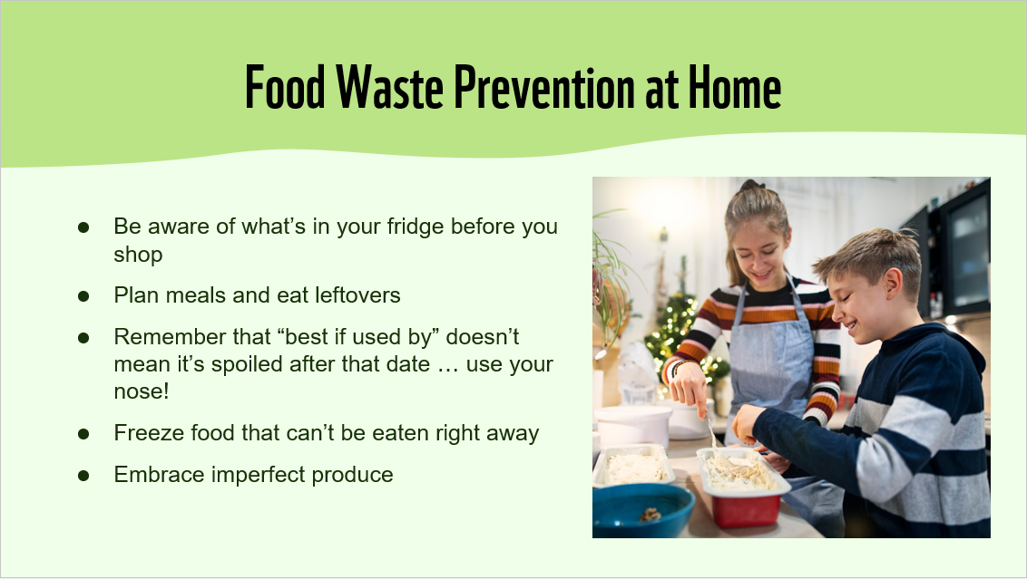
Notes:
Discuss the suggestions given here. You may want to see if students have additional ideas for preventing food waste.

Slide 16
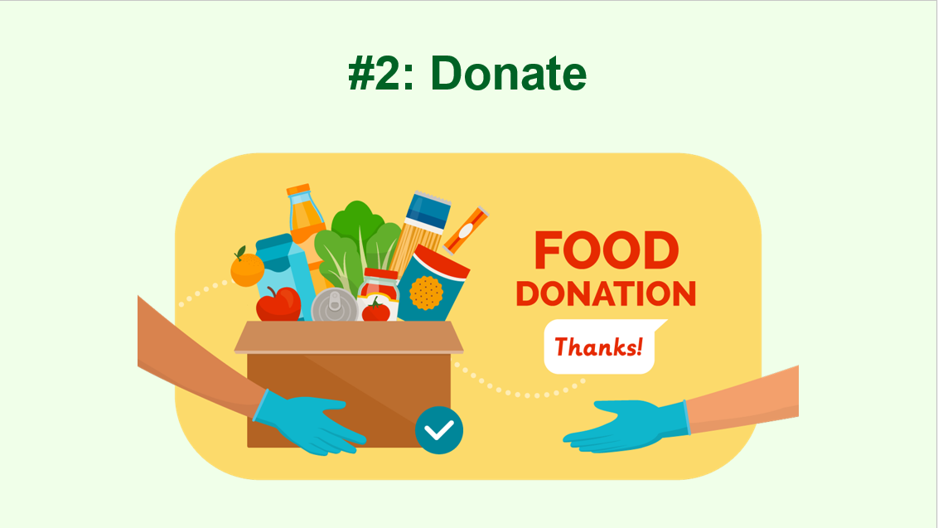
Notes:
Those are good strategies for preventing food waste. But it’s inevitable that some food will be discarded, and it’s important to consider what we should do with that food. The second strategy for fighting food waste is “donate.”
Like we talked about earlier, many people face food insecurity. Some unwanted food can go to those in need. Ask students if they know of places that accept food donations (food pantries, food banks, homeless shelters, youth/senior centers, etc.).
Another solution is to establish a share table at school. At a share table, students leave unopened, packaged food and fruits with non-edible skins for others who might want it. Do you have a share table at your school? If not, is this something you could establish?

Slide 17
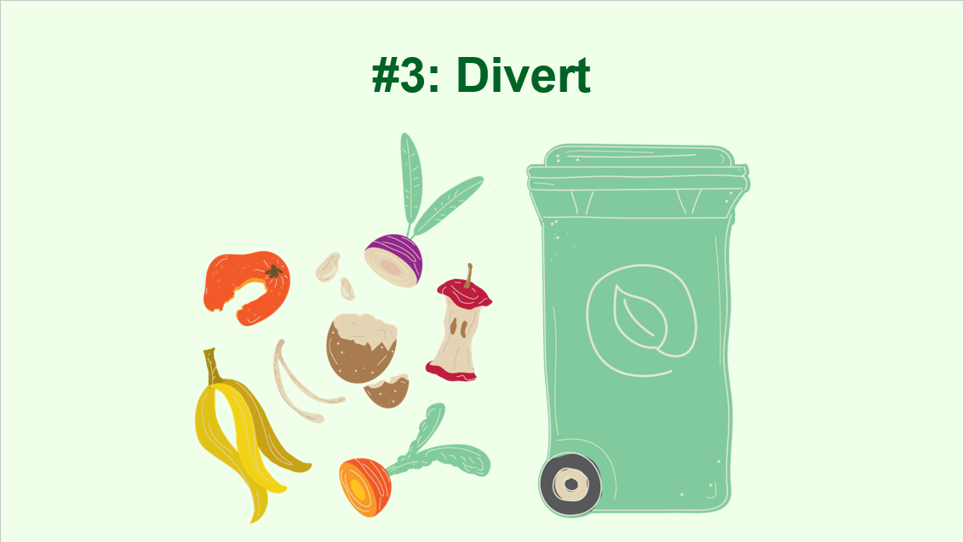
Notes:
The third way we can fight the negative impact of food waste is to “divert” food from landfills. We can do this by composting. Composting is letting organic matter decompose and then reusing it as fertilizer. Not all food waste can be composted. Fruits and vegetables, nutshells, teabags, coffee grounds, and eggshells can all be composted. Dairy products, meat and fish, bones, and baked goods cannot. As we discussed earlier, not only does composting allow us to reuse waste in a helpful way, it also produces much less greenhouse gas than if that same food were in a landfill.
You can start a compost pile at home or at your school. Many cities have resources for starting school gardens, and a compost pile is a perfect way to start. You may even be able to partner with local farmers to have your food waste picked up and used as animal feed or farm compost.
Try brainstorming some interventions for where food might be diverted. Here are ways to get your students started: call a local food bank or church pantry, send a letter to the city asking for a composting program, or reach out to a farmer who might be willing to take in composting.

Slide 18
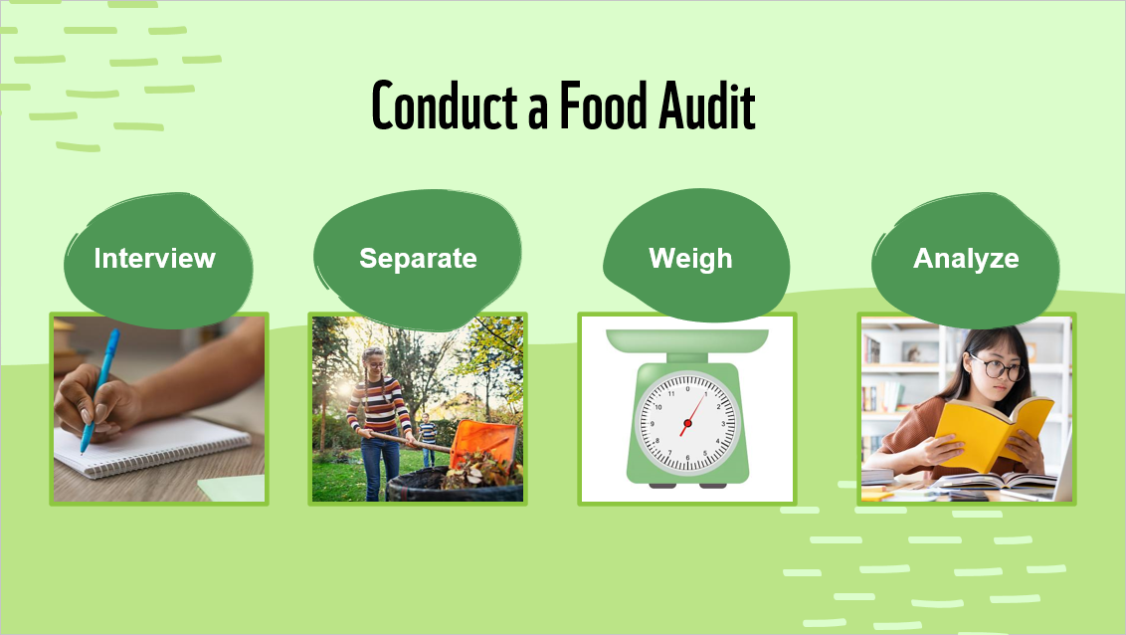
Notes:
The Food Recovery Hierarchy is a high-level look at food waste strategies. But we want to make a difference right where we live.
As we mentioned earlier, one way to fight food waste at school is to measure exactly how much we are wasting. This is called a food audit. You can hold a food audit on one day or over several days. The goal is to learn how much is being thrown away and why. Students are interviewed about what they are throwing away. Before food is discarded, it is separated from wrappers and can be sorted into type. Then it is weighed. After the audit, students analyze their results, discuss why people are throwing away food, and share ideas for helping to reduce the amount of food wasted at school. You can now discuss the specifics of your food audit. If your school is online, you can still do a food audit! See the lesson and discuss alternatives as a class.

Slide 19
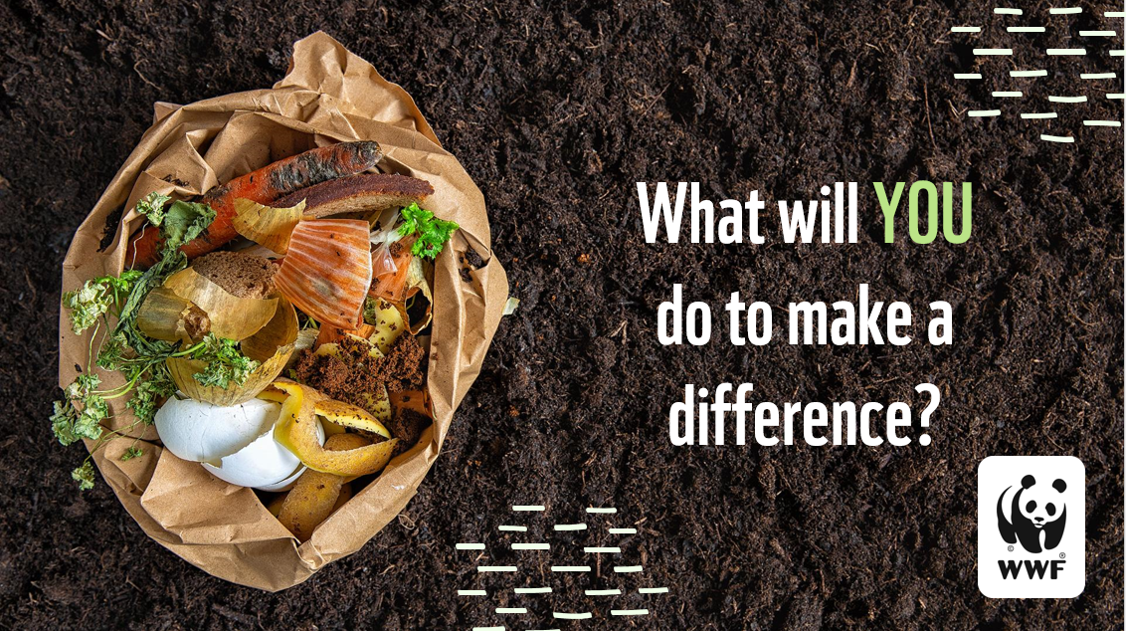
Notes:
Reiterate that food waste is a huge problem that impacts our planet. Ask students to share the costs of food waste to the environment. Then challenge them to consider (and share) ways they can make a difference (start composting at home, eat leftovers, save uneaten food for later, take smaller portions, etc.).

