Slide 1
Sustainable Restaurants

Slide 2
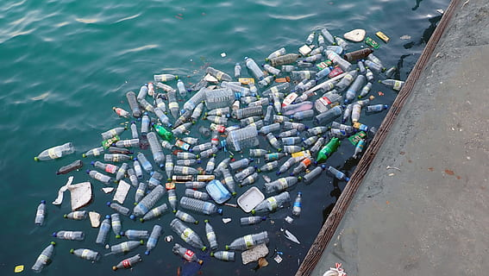
The Plastic Problem
Over 5 trillion pieces of plastic are floating in the ocean
79% of the plastic produced has ended up in landfills or the environment
About 63 billion straws are used annually in the US

Slide 3
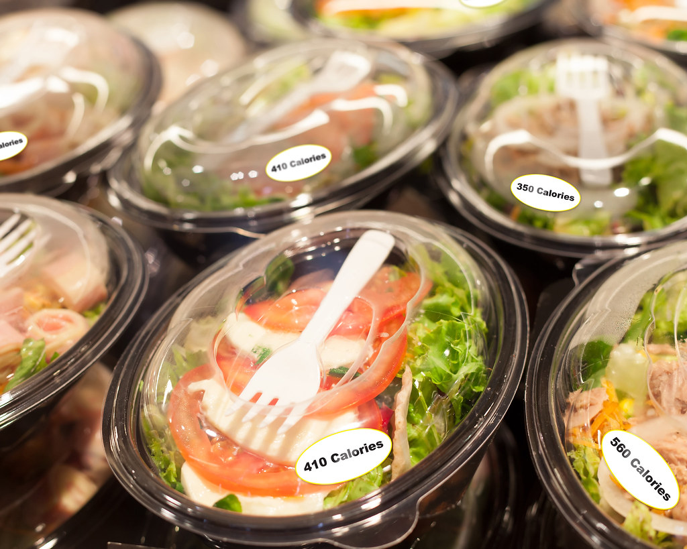
How can restaurants make a difference?
Restaurants produce a lot of plastic waste through take out containers, straws, and wrappers
Water bottles that stores and restaurants sell have little chance to be recycled (only 31% in 2015)
They also use a lot of water-about 5,800 gallons per day

Slide 4
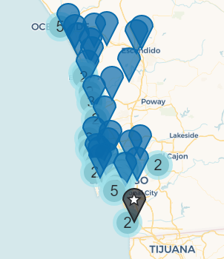
Sustainable Restaurant Practices
Five mandatory practices:
Use only reusable tableware when guests are dining in
Follow proper recycling guidelines and practices
Do not use Styrofoam at all-options for take-out can be paper or aluminum based
Do not offer plastic bags or utensils with take out orders, unless requested
Do not offer straws unless requested, and then offer paper straws

Slide 5
Sustainable Restaurant Practices
Optional Criteria (must select 2)
Do not sell drinks in plastic bottles
Offer discounts for people who bring in their own mugs, cups, or containers
Offer vegan and vegetarian options
Offer only Best Choice or Good Alternative seafood
Make efforts to conserve water, save energy, and mitigate pollution

Slide 6
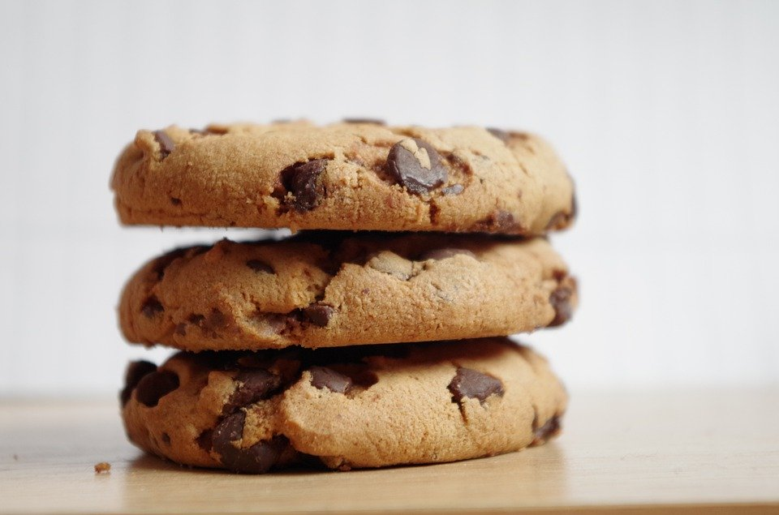
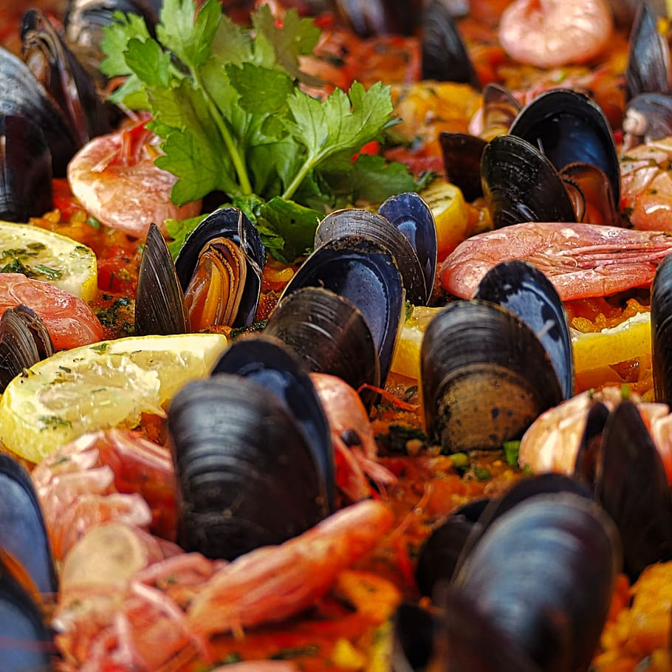
Local Sustainable Restaurants and Businesses
Soul Much Cookies
Partners with chefs to collect extra grain and produce scraps from restaurants and juice bars, then use the rescued food to make cookies!
Point Loma Seafoods
Serves sustainably caught seafood, some of which is caught locally by San Diego fishermen

Slide 7
Choosing sustainable seafood means picking seafood that has been fished or farmed in a way that has a lower impact on the environment

Slide 9
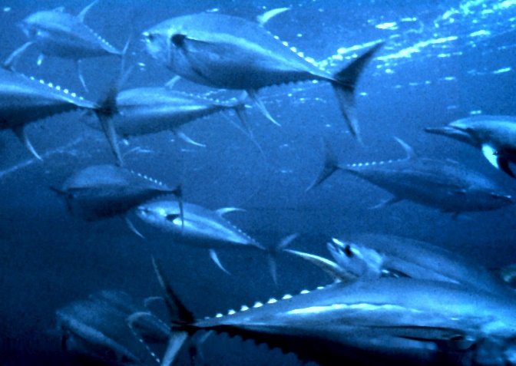
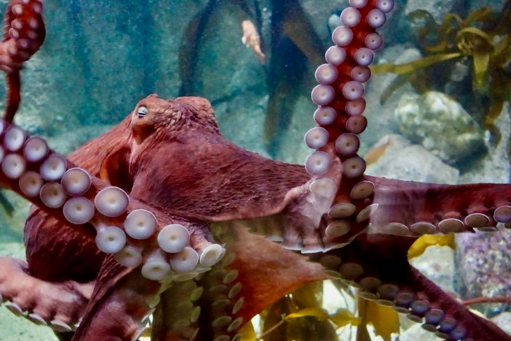
Sustainable Seafood Trivia!
Which kinds of tuna are the best and worst choices?
What is the least sustainable species of salmon?
Is mahi mahi a sustainable seafood? Why or why not?
How sustainable is octopus?
What do many of the options in the "Best Choice” category have in common?

