Slide 1
Creative Communication & Climate Change
Notes:
*This was produced by UCI Science Project under award No. NA22OAR0170210 from the Ocean Acidification Program of the National Oceanic and Atmospheric Administration (NOAA), U.S. Department of Commerce. The statements, findings, conclusions, and recommendations are those of the author(s) and do not necessarily reflect the views of NOAA or the U.S. Department of Commerce.
Link to Teacher Overview Document for lesson sequence and flow
Student Worksheet
TOA Toolkit PDF
Printouts of each piece of artwork

Slide 2
Lesson 1
The Ocean as Climate’s Heart
Communicating Creatively
Notes:
Lesson 1
Investigative Phenomenon Question: How does the ocean serve as climate’s heart and what are the ways that we can advocate for the health of the ocean?
Teacher Preview:
Student Worksheet - Students can use these guided notes to record their thoughts throughout each lesson.
Students will express their thoughts about what the ocean means to them through creating art (drawing, poem, song, etc)
Students will interpret art by Alisa Singer, founder of Environmental Graphiti®. They will notice how color, texture, patterns, and symbols are ways to communicate information in powerful and meaningful ways. Students will observe and interpret the graph that inspired the art for the piece titled Relationship between Emissions Levels and Temperature Rise.
Students will revisit their original art through the lens of climate change. They will discuss how the ocean serves as climate’s heart and begin thinking about how their art can both draw people in as well as educate them.
Their homework will be to complete Day 1 in their Creative Journals.

Slide 3
Create anything that comes to mind for “Ocean Art”.
Notes:
Teacher Background:
Expressing ideas through art invites a wider audience into the conversation of the ocean, as each student will have different ideas, thoughts, questions, and relationships with the ocean. Some students may have never been to the ocean before, while others may have a deeper relationship with the ocean. In regard to the later topics of climate change and ocean acidification, data scientists communicate their information through graphs, numbers, and complex pathways. Art can be used to creatively communicate ideas and elicit conversations from people of all backgrounds, not just scientists.
Provide canvas paper and pencils for students to create their initial artwork. Color and other art materials will be used in later lessons when students add or modify their art.
Teacher Guidance:
Invite students to close their eyes for a moment and imagine the ocean. Pose the following questions to elicit their funds of knowledge regarding the ocean:
Have you been to the ocean? When? When you think of the ocean… What do you see? Are these living or nonliving things? What do you know about them? How does it smell? What do you hear? What is making these noises?
If you have not been to the ocean, perhaps you have seen it in a movie or show. How would you describe it? What were the people doing?
How do these things make you feel?
Students will spend 10 minutes independently creating a piece of art that conveys what they just imagined. Their art can be a drawing, poem, song, story, etc. If they wish to make something more tangible (sculpture, digital art, etc) encourage them to sketch it first and in pencil only (for now).
For students who have never been to the ocean, encourage them to think of what they have seen in movies, shows, or what they imagine the ocean to be like. Their art can also involve wonderings and questions, which can change over the next few days as they learn more about the ocean.

Slide 4
Share-Out
Notes:
Teacher Background:
Keep track of the ideas that are shared out. Students may share out both scientific or academic words, or they may share personal experiences or prior knowledge. It is important to acknowledge and affirm their thoughts and let them know that the next few days will offer time to reflect on what they know as well as gain new knowledge about the ocean. Students will also have a structured protocol to give and receive feedback in Lesson 2.
Teacher Guidance:
Students will share in small groups of 3-4. To facilitate small group presentations, ask students to share the following about their art:
Why they chose that type of art (drawing, poem, story, sketch)?
How they felt making it?
As students are sharing about their art, ask the other students to provide any feedback regarding the art. For example:
I appreciate your piece of art because…
I’m curious about…
This artwork reminds me of…
I like this artwork beecause….
As students share out, note the following terms if they are mentioned. Be sure to highlight them or record them in an area that can be revisited:
Weather or climate
Climate change
Pollution (litter, oil/gas, chemicals)
Greenhouse gasses or carbon emissions or carbon dioxide
Ocean acidification
Human impact
Animals (coral reefs, shelled animals)

Slide 5
Let’s look at art inspired by climate change.
What do you think the artist is trying to convey here?
Notes:
Teacher Background:
Relationship between Emissions Levels and Temperature Rise by Alisa Singer. It is based off a graph that shows how historical increases in global surface temperatures correlate directly with increases in carbon emissions in the post-industrial age. If climate change refers to long-term shifts in temperatures and weather patterns, this graph provides important evidence of factors contributing to climate change.
Teacher Preview:
Students will make observations about this piece of art. They will consider how the artist felt when she was creating it, by interpreting the color, texture, patterns, and symbols. In a later slide, students will see the graph that inspired the art and students will consider how scientists communicate their ideas about climate data.
Teacher Guidance:
Provide each group of 3-4 students with a copy of just the artwork. (Link)
Give students a quick 3 minutes to brainstorm what they think the artist is trying to convey. Students will write their ideas on the handout under “Art inspired by climate change (Image 1)”
What do you think the artist is trying to tell you? Since this is the students’ first time interpreting artwork, they may not notice the trend lines embedded within. Students may focus on the overall feeling they get when looking at the artwork.
How do you think the artist felt while creating this digital art? Why do you think that?
Ask each group to share one thought they had about the artwork and the artist.

Slide 6
Meet the artist!
Alisa Singer, founder of Environmental Graphiti®.
Notes:
Teacher Background:
Alisa Singer founded Environmental Graphiti project and created the series The Art of Climate Change, with abstract images illustrating the science behind the critical changes impacting our planet. Environmental Graphiti® is a collection of over 75 digital paintings, each derived from a chart, graph, map, word or number representing a key fact about climate science. (Environmental Graphiti)
Teacher Guidance:
Students will watch the video and learn more about the artist behind the digital art. As they hear Alisa’s story, encourage students to reimagine how communicating climate data in science can be a creative outlet to convey a more personal, meaningful and powerful message to an issue that desperately needs to be addressed by a larger audience.

Slide 7
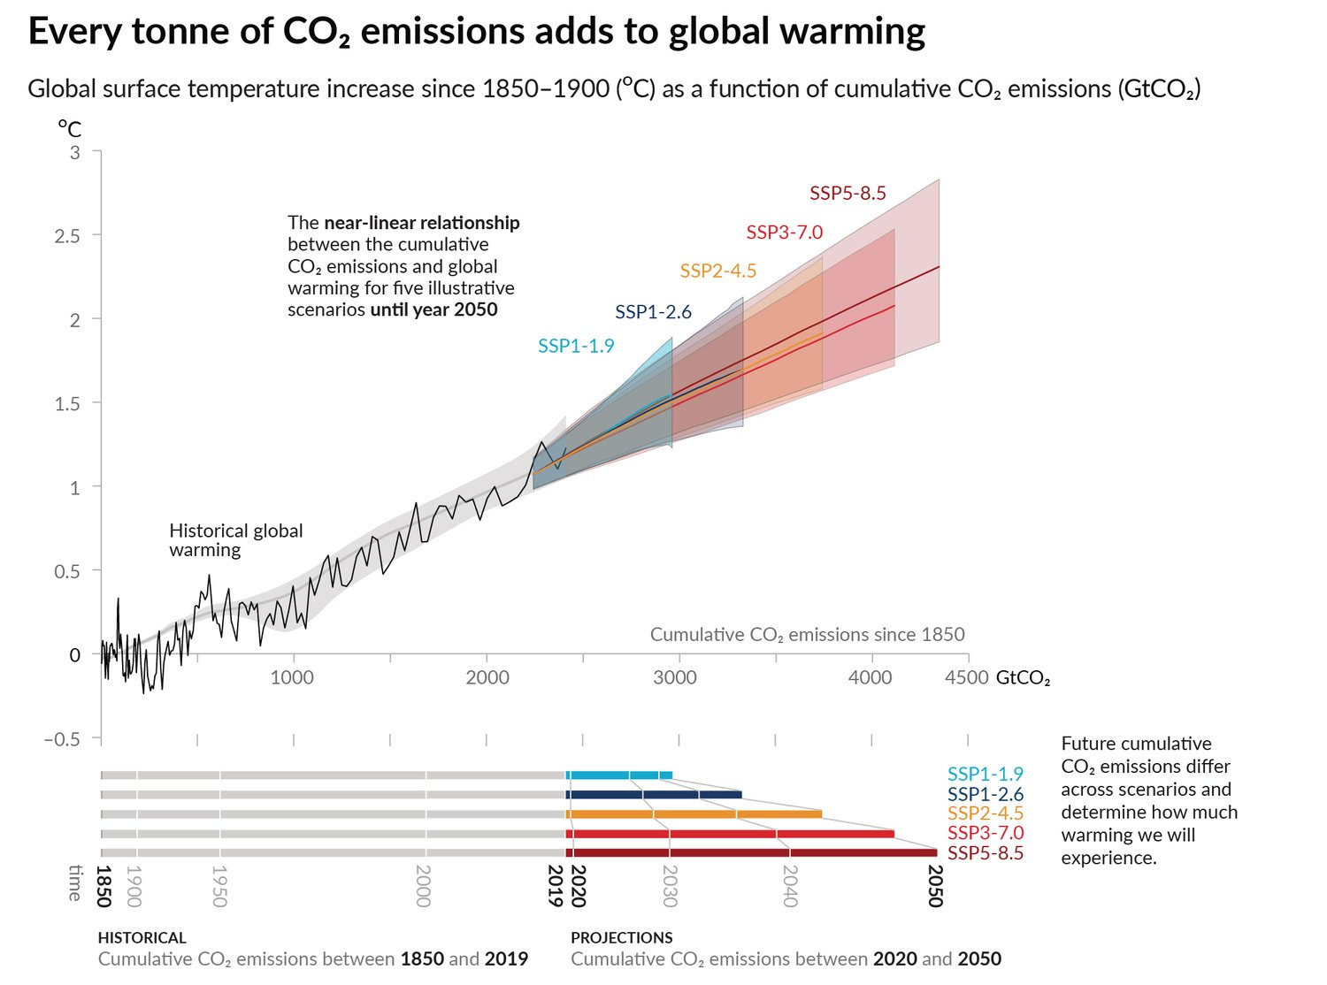
Art Inspired by Climate Change
Relationship between Emissions Levels and Temperature Rise
Notes:
Teacher Background:
This slide is to show students how scientists communicate and present data. While it is important to make sense of the data, art is a powerful tool to communicate about science. Like Alisa mentioned in the video, art can draw from personal experiences and relate to all people from varying backgrounds. This is important when talking about climate change, because it allows the everyday person to understand climate change without being a scientist.
Climate change refers to long-term shifts in temperatures and weather patterns. (UN) This graph represents evidence of the root of climate change: rampant increased carbon emissions and its effects on global surface temperatures. Students will see in a short video later how the warming of Earth affects the ocean.
If students require more support for the difference between weather and climate, visit https://climatekids.nasa.gov/climate-change-meaning/
Specific scaffolding for this graph are found on the next slide.
Teacher Guidance:
Pass out the Data for Image #1 for to each group. Students will see the piece of art side-by-side with the climate science data that inspired it. Before interpreting the data, students will compare how each figure conveys information. Ask the following questions, “How do scientists communicate data about climate change? Do you think this type of communication reaches a wider audience?” They may say the information is important to understand but at first glance, the graph can seem confusing with the different axes, lines, colors, and abbreviations.
With a partner, students will make observations about the graph. Students can fill in the title of the art, “Relationship between Emissions Levels and Temperature Rise” and write their observations (under “What I notice”) on the student handout. Students may observe:
X-axis = Cumulative CO₂ emissions since the 1850s (in Gigatonnes of CO₂)
Y-axis = Temperature anomaly in Celsius
Various SSP values → Future cumulative CO₂ emissions differ across scenarios and determine how much warming the Earth will experience
Students can then interpret the graph. Pose the following questions to check for understanding. Students will answer the questions on the handout.
What is the graph telling us about the relationship between temperature and carbon emissions? Historical increases in global surface temperatures correlate directly with increases in carbon emissions in the post-industrial age.
Why do you think this relationship is important? This relationship allows scientists to predict future temperature increases, which impacts the decisions of policymakers, individuals, businesses, etc.
SSP values stand for “Shared Socioeconomic Pathway”, which show projections into the future. Why are there various SSP pathways? What dictates those patterns? The amount of global warming that will be experienced by the planet will depend on how quickly humans curb CO₂ emissions. They are dictated by how much CO₂ is emitted, as well as other socioeconomic factors such as population, urban density, education, land use and wealth.
Students will build a shared understanding of climate change and fill in the student handout. Students will share their ideas with a partner before the teacher facilitates a whole-class discussion.
How is the graph evidence of climate change? It is showing global temperatures increasing over a long period of time (with projections into the future).
What is climate change in your own words? Climate change refers to the changes in global temperature over time due to the amount of CO₂ emissions, it is impacted not just by the emissions but changes in socioeconomic changes across communities.
Students will make connections back to ocean art. Pose the following question to elicit student ideas:
Now that you know the science behind the art, how do you think the artist felt while creating this digital art? Why?
How does this information relate to the ocean?
How does the ocean interact with the atmosphere?
How will rising global temperatures affect the ocean?

Slide 8
Notes:
Further support for reading this graph:
Ask students to identify terms and patterns they are familiar with. Clarify the X and Y axes of the top graph and mention the bottom bars below the graph is an extension of the graph above it. Students may mention they are familiar with:
The terms CO2 emissions and global warming
The direct relationship between CO2 and temperature
Ask students to identify parts of the graph they are unfamiliar with or have questions on. Students may mention:
The temperature only increases by 0.5 degrees Celsius and it also goes into the negatives
In this case, review how to read temperature anomalies (Y-axis): The anomaly, or baseline, temperature is typically computed by averaging 30 or more years of temperature data. A positive anomaly indicates the observed temperature was warmer than the baseline, while a negative anomaly indicates the observed temperature was cooler than the baseline (NOAA)
What “GtCO2” represents
X-axis = Cumulative CO₂ emissions since the 1850s (in Gigatonnes of CO₂)
What are SSP values?
The graph shows the correlation between increased global surface temperatures and carbon emissions (CO₂) over time. The SSP values are projections of warming in the future, based on various scenarios. SSP stands for “Shared Socioeconomic Pathway”.
The scenarios are the result of complex calculations that depend on how quickly humans curb greenhouse gas (CO₂) emissions, as well as socioeconomic changes in global communities.
Opportunity for an extension: you may dive deeper into socioeconomic changes by providing examples. These changes may include: population, urban density, education, land use and wealth. For example, SSP1-1.9 is the IPCC’s most optimistic scenario. This describes a world where global CO₂ emissions are cut to net zero around 2050. Societies switch to more sustainable practices, investments in education and health increase, and. inequality falls. The world has avoided the worst impacts of climate change. (Reuters)
Supporting students in making connections between the top graph and the bottom graph:
The gray shaded region represents the historical CO2 emissions between 1850 and 2019. The colored regions represent SSP projected pathways. The color coded bars beneath the graph show a visual representation comparing the amount of CO2 emissions in that pathway to the historical data. This is related to the top graph because the lines represent how much the Earth is warming in that project year based on carbon emissions. Essentially, there will be increase warming, but the rate in which the Earth warms is based on the SSP pathway.

Slide 9
How does the ocean serve as climate’s heart and what are the ways that we can advocate for the health of the ocean?
Notes:
Teacher Background:
As Earth warms, the ocean reacts in multiple ways: it absorbs heat as well as carbon dioxide. Due to these tendencies of the ocean, the ocean plays an incredible role in regulating Earth’s weather and climate. Consider the ocean as the beating heart of Earth. Just as a heart circulates blood and regulates the body’s temperature, the ocean regulates climate through the circulation of heat, moisture, and carbon, throughout Earth’s system. (NNOCCI Climate’s Heart)
Teacher Guidance:
Given the data from the previous slide, students will consider the investigative phenomenon question: “How does the ocean serve as climate’s heart and what are the ways that we can advocate for the health of the ocean?”
Students will talk in pairs about the following guiding questions. They can also List, Write, or Draw their ideas on the student handout.
What thoughts comes to mind when reading this question?
What is climate? What is the ocean’s role in climate?
What does it mean to be the “heart” of a system? How could the ocean be like a “heart” for Earth?
See Teacher Discourse and Talk Moves for more ways to facilitate conversations and clarify what students might be sharing.

Slide 10
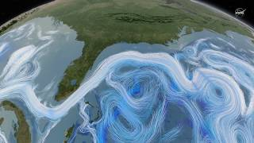
The ocean is climate’s heart.
How does the video convey the importance of the ocean?
Notes:
Teacher Background:
The video will provide information about the ocean’s role in climate. The ocean has the ability to absorb heat and carbon from the atmosphere. However, warming waters are causing ocean circulation to slow down. Warming waters and increase carbon dioxide in the ocean also has detrimental effects to marine life, which will be highlighted with ocean acidification in the next lessons.
Teacher Guidance:
Students will watch the video and continue to think about how information is communicated. Students may notice the computer graphics showing arrows to show movement (ocean currents). The viewpoint starts in an aerial view (in the atmosphere) and then dives into the ocean layers. The arrows are bright and captivating. The text is short and succinct, and the music also adds a dramatic effect but it is not distracting from the science.
Video credit: NASA

Slide 11
How can you creatively communicate through art?
Time to edit!
Revisit your art from the beginning of class.
Consider how you interpreted Alisa Singer’s art. How do YOU want to convey what you see, hear, or feel about the ocean?
As you learn something new every day, you will add or modify your art!
Notes:
Investigative Phenomenon: How does the ocean serve as climate’s heart and what are the ways that we can advocate for the health of the ocean?
Teacher Background:
Guide students to shift their thinking about the ocean from the beginning of class to how the ocean serves as climate’s heart. Given the data from Relationship between Emissions Levels and Temperature Rise graph and the video on the previous slide, students should notice that the ocean
Teacher Guidance:
Students will revisit the art they created at the beginning of class.
Students will consider how they interpreted Alisa Singer’s art, how she must have felt, and what she was trying to convey.
Students will adjust their art so the meaning is creatively communicated. Make edits in pencil only for now.
Students will add or modify their art every day as new information and evidence is revealed about the ocean, how it is changing due to climate change, why it matters, and what can be done.
Since students are creating various forms of art, consider posing the following question to elicit ideas on how they aim to convey meaning in their work, “What are important components you will need to include in your style of art (drawing, painting, or written work) so that it carries a message?” (This message will be edited and it will change as students learn new things about the ocean.)
Students who are creating a drawing or painting may mention including visuals, symbols, patterns, color, or texture
Students who are creating written work may mention using descriptive words or phrases that promote a visualization for the reader/audience

Slide 12
Homework: Lesson 1 Journal Entry
How did your art change today?
What was your reasoning for the changes?
Describe in detail how your art changed.
How did the information from today’s lesson influence your art?
Notes:
Teacher Background:
Students will keep a journal over the five-day lesson period. At the end of every lesson, students’ homework will be to reflect on how their art changed and why it changed. This process mirrors the cyclical and iterative nature of science. It will also serve as evidence for the teacher to see how students’ knowledge on the ocean and climate change change over time.
Creative Journal - Students can make a copy into their Google Drive. If students do not have personal devices at home, provide printed copies.
Force copy link - post online for students, this link will force a copy into their drive. Remind students to keep their files organized in folders.
Printed copies - print a copy for students if they do not have access to devices at home
Teacher Guidance:
Show students their Creative Journal they will be filling in over the next five days. They will describe the changes they made to their art and provide an explanation for their changes. Encourage students to reflect on how they are communicating the information they learned that day, and similar to how scientists communicate their findings, their thoughts may change over time.

Slide 13
Notes:
This slide is intentionally left blank.

Slide 14
Lesson 2
The Ocean as Climate’s Heart
The Meaning of Ocean Acidification
Notes:
Lesson 2
Investigative Phenomenon: How does the ocean serve as climate’s heart and what are the ways that we can advocate for the health of the ocean?
Teacher Preview:
Students will interpret another piece of art by Alisa Singer. It draws attention to the shape and patterns of marine life and how they are affected by ocean acidification.
Students will think about ocean acidification and what it means, looks like, its causes and effects, through a pteropod video and exploring The Ocean Agency Toolkit for Ocean Acidification.
Students will edit their art and intentionally build in some type of imagery, icon, or pattern that resonated with them from the toolkit. This will center their artwork and continue to creatively communicate their growing knowledge of ocean acidification.
Students will engage in a partner feedback session, where they will conduct a “Glow and Grow” conversation to provide specific and meaningful feedback to each other’s ocean art.
Their homework will be to complete Day 2 in their Creative Journals.

Slide 15
Let’s look at more art inspired by climate change.
What do you think the artist is trying to convey here?
Notes:
Teacher Background:
Ocean Acidification Threatens Marine Life by Alisa Singer. It is based off an image of a pteropod (sea butterfly) and the effects of ocean acidification. Its shell is deteriorating due to acidification of the ocean.
Similar to Day 1, students will make observations about this piece of art. They will consider how the artist felt when she was creating it, by interpreting the color, texture, patterns, and symbols.
For a brief overview of Ocean Acidification, see the Teacher Overview Document.
Teacher Guidance:
Provide each group of 3-4 students with a copy of just the artwork. (Link)
Give students a quick 3 minutes to brainstorm what they think the artist is trying to convey. Students will write their ideas on the handout under “Art inspired by climate change (Image 3)”
What do you think the artist is trying to tell you? Students may notice the unique shapes in this art compared to the art from Lesson 1.
How do you think the artist felt while creating this digital art? Why do you think that?
Ask each group to share one thought they had about the artwork and the artist.

Slide 16
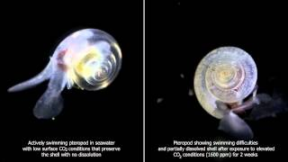
Ocean Acidification Threatens Marine Life
Notes:
Teacher Background:
The video shows an animation of the pteropod, or “sea butterfly”, in two scenarios. Pteropods are small, ecologically important mollusks in a marine food web, specifically coastal ecosystems (which are most affected by ocean acidification). The video shows the results of pteropods in laboratory conditions. On the left shows a pteropod that was exposed to normal waters (low surface CO₂ levels) and the right a pteropod showing the effects of living in acidified water (elevated CO₂ levels) for the same time period. The white lines indicate shell dissolution and explain why ocean acidification is called "osteoporosis of the sea. (NOAA)
When students revisit their art later, students will consider the power of shapes, symbols, and patterns when communicating a message through art.
Teacher Guidance:
Pass out the Data for Image #2 for to each group so they may reference it during the video. Students will watch the animation that inspired the art. Students can fill in the title of the art, “Ocean Acidification Threatens Marine Life” and answer the questions (under “Check for Understanding”) on the student handout:
What do you notice about the pteropod? How does the pteropod compare in each scenario? The pteropod on the left was exposed to low CO₂ levels and seems to be swimming fine. The one on the left was exposed to elevated CO₂ conditions for two weeks. It has a disintegrated shell and is struggling to swim.
What animal does it remind you of? What do you know about these types of animals? The pteropod looks like animals with shells or exoskeletons. These shells are hard exteriors that protect the animal in various ways. These shells are made of calcium carbonate (compare to eggshells or chalk).
How does the video relate to yesterday’s climate data? The data yesterday shows a rampant increase in CO₂ emissions. This video shows how CO₂ can end up in the ocean and is detrimental to marine life.
Based on the video, what is CO₂ doing to the ocean water? How is it affecting the pteropod? The ocean is becoming “acidified” and is disintegrating the shells of shelled organisms.
Revisit Alisa Singer’s art. What new shapes and patterns are you noticing? The spiral shape of the shell is masked but still visible. The disintegration of shells is displayed through a stipple brush-like pattern.
Students will exchange ideas in pairs. Facilitate a whole class discussion regarding relationships between the image and data shown from Day 1 and what they are seeing in the video. Students should make the connection between the increased levels of CO₂ affecting the ocean by ocean acidification. Students will learn more about what that means and other effects on ocean life and humans using The Ocean Agency toolkit.
Video Link https://www.youtube.com/watch?v=6H_VDhXiFk4

Slide 17
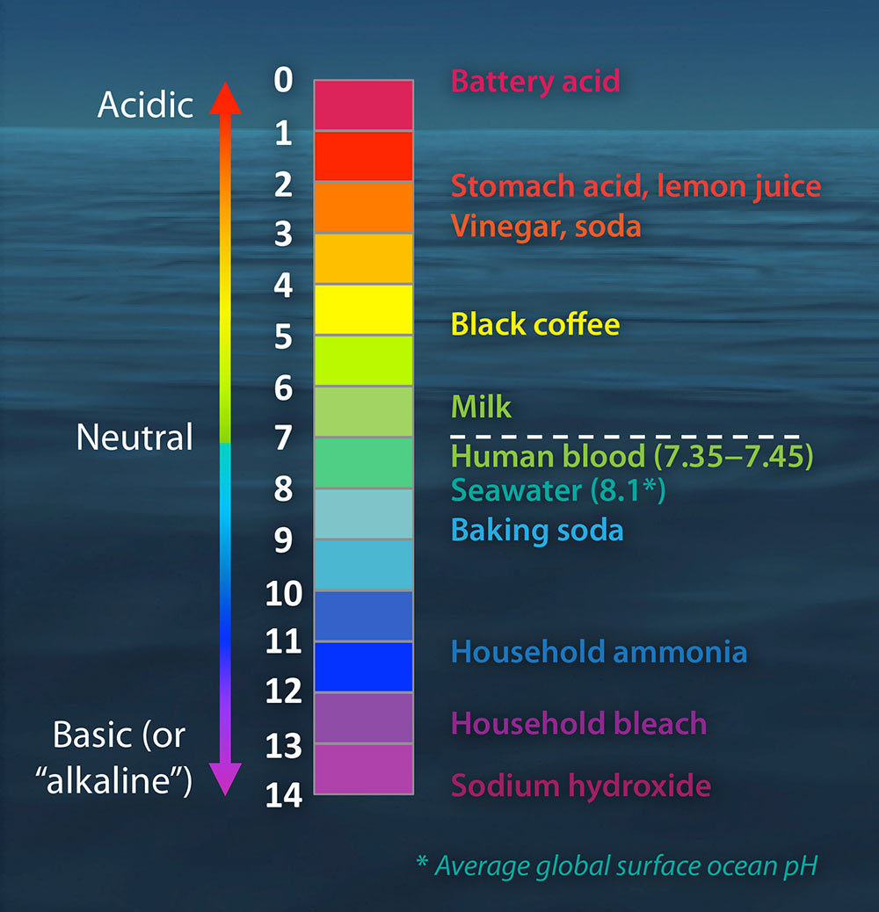
What does “acidification” mean?
Let’s look at the pH scale!
What do you notice? What questions do you have?
If the ocean is becoming more acidic, which direction does it move on the scale?
Notes:
Teacher Background:
So that students have a shared understanding of what the term “acidification” means, review the pH scale.
Just as temperature is described as an increase in from -40°F to -20°F as “warming”, even though neither the starting nor the ending temperature is “warm,” the term “acidification” describes a direction of change (i.e. increase) in the level of acidity in the global oceans, not an absolute end point.
Since the Industrial Revolution, the global average pH of the surface ocean has decreased by 0.11, which corresponds to approximately a 30% increase in the hydrogen ion concentration (since the pH is on a logarithmic scale) NOAA
Teacher Guidance:
After watching the pteropod video, students will consider what it means for the ocean to be “acidifying”.
(This slide is animated) Before the scale appears on the screen, prompt students to look at the empty pH scale on their handout. Students will chat with a partner briefly about what the numbers mean and what substances they think are categorized on either end of the scale.
Consider posing the following questions to elicit student thinking:
What do the numbers represent? Where would more “acidic” things fall under?
Where do you think average seawater falls? Why do you think that?
How do substances become more acidic? If the ocean is becoming more acidic, which direction does it move on the scale?
The video shown in the next lesson will go further into the science behind the reaction between CO₂ and water.
Image credit UC Davis

Slide 18
Let’s explore ocean acidification.
Notes:
Teacher Background:
The Ocean Agency Ocean Acidification Toolkit gives students a preview of the “7 things absolutely everyone should know about ocean acidification”. As students explore the toolkit, they will gain a basic understanding of the causes and effects of ocean acidification. They will add or modify their art according to one of the 7 sections to focus on ocean acidification.
Toolkit screenshots
PDF to print - print a copy for students to share in partners if they do not have access to devices
Teacher Guidance:
Students will explore the online toolkit OR read through the printed PDF. They will need to consider which of the 7 topics from the toolkit they are interested in learning more about and integrate into their art.
If students are not sure where to start, consider posing the following questions to guide their thinking:
How might this inspire you in your artwork?
What can you cling to? What information resonates with you (what do you feel connected to)? (Example: Alisa focused on #4 with the shells)
What imagery, icons, or patterns can you use to center your artwork and communicate ocean acidification?
What questions do you have about your topic? What kind of data might you be interested in looking at to deepen your understanding of your topic?

Slide 19
How does the ocean serve as climate’s heart and what are the ways that we can advocate for the health of the ocean?
Notes:
Teacher Background:
Reminder note: Just as a heart circulates blood and regulates the body’s temperature, the ocean regulates climate through the circulation of heat, moisture, and carbon throughout Earth’s system. (NNOCCI Climate’s Heart)
Teacher Guidance:
Students will revisit the investigative phenomenon question. Students will discuss in pairs the big ideas from Lesson 1 and 2 so far and what have they learned so far to address the question. Students can write their thoughts on their handout. Their answers may sound like:
Lesson 1 - Climate change is changing the chemistry of the ocean. The ocean is climate’s heart.
Lesson 2 - The ocean is absorbing carbon dioxide which regulates the heat in the atmosphere, but it is harming marine life in multiple ways (TOA toolkit)
Review any of the key terms that might have been mentioned in Lesson 1 and how it relates to ocean acidification:
Weather or climate
Climate change
Greenhouse gasses or Carbon emissions or Carbon dioxide
Human impact
Animals (coral reefs, shelled animals)

Slide 20
How can you creatively communicate through art?
Time to edit!
Revisit your art. Keep in mind: How do YOU want to convey what you see, hear, or feel about ocean acidification?
What resonated with you as you explored the toolkit? What imagery, icons, or patterns can you integrate into your art?
As you learn something new every day, you will add or modify your art!
Notes:
Investigative Phenomenon: How does the ocean serve as climate’s heart and what are the ways that we can advocate for the health of the ocean?
Teacher Background:
At this point, students should be considering how their art can creatively convey a powerful message about ocean acidification.
Students will continue to add or modify their art every day as new information and evidence is revealed why ocean acidification matters and what can be done.
Teacher Guidance:
Students will revisit their art and consider how they interpreted Alisa Singer’s art, what they observed in the pteropod video, and information that resonated with them from the TOA toolkit.
Students will adjust their art by intentionally embedding symbols or patterns to convey newfound knowledge, thoughts, and feelings toward ocean acidification. Make edits in pencil only for now. Since students are creating various forms of art, consider posing the following questions to elicit ideas on how to embed symbols or patterns in their work:
If you are creating a drawing or painting, what symbols or patterns did you see in the toolkit that can help you center your art in ocean acidification?
If you are writing a song, poem, or story, what words or phrases can you use to convey what you know and are thinking toward ocean acidification?

Slide 21
Feedback
If you are unsure how to give specific and meaningful feedback, follow the steps to conduct a “Glow and Grow” conversation.
bit.ly/GLOWANDGROWTALK
Notes:
Teacher Background:
Part of communicating information in science is the act of receiving feedback from peers or colleagues. It is important to tell students that they have the opportunity to accept the feedback given or respectfully reject feedback. Students should know that they have to listen to the feedback of their classmate, but they are not obligated to follow the advice. The final choice is always theirs. (Art of Education)
Teacher Guidance:
Provide printed copies of the Glow and Grow protocol or project the bit.ly on the screen so students can access the PDF on their own device.
Students will engage in the feedback activity with a partner. They can record any notes on the student handout and apply any changes to their art on the next day.
Image Credit Art of Education

Slide 22
Homework: Lesson 2 Journal Entry
How did your art change today?
What was your reasoning for the changes?
Describe in detail how your art changed.
How did the information from today’s lesson influence your art?
Notes:
Teacher Guidance:
Students will fill in Lesson 2 in their Creative Journal. They will describe the changes they made to their art and provide an explanation for their changes. Encourage students to reflect on how they are communicating the information they learned that day.

Slide 23
Notes:
This slide is intentionally left blank.

Slide 24
Lesson 3
The Ocean as Climate’s Heart
Building a powerful message
Notes:
Lesson 3
Investigative Phenomenon: How does the ocean serve as climate’s heart and what are the ways that we can advocate for the health of the ocean?
Teacher Preview:
Students will develop a deeper understanding as to why carbon dioxide is the root cause of the issue by breaking down the chemistry behind ocean acidification.
Students will interpret another piece of art by Alisa Singer. It draws attention to the different scenarios for reducing emissions based on human behavior and mitigating carbon emissions.
Students will revisit their art and consider how they interpreted Alisa Singer’s art, what they learned about the chemical reaction for ocean acidification, and new information that resonated with them from the TOA toolkit.
Their homework will be to complete Day 3 in their Creative Journals.

Slide 25
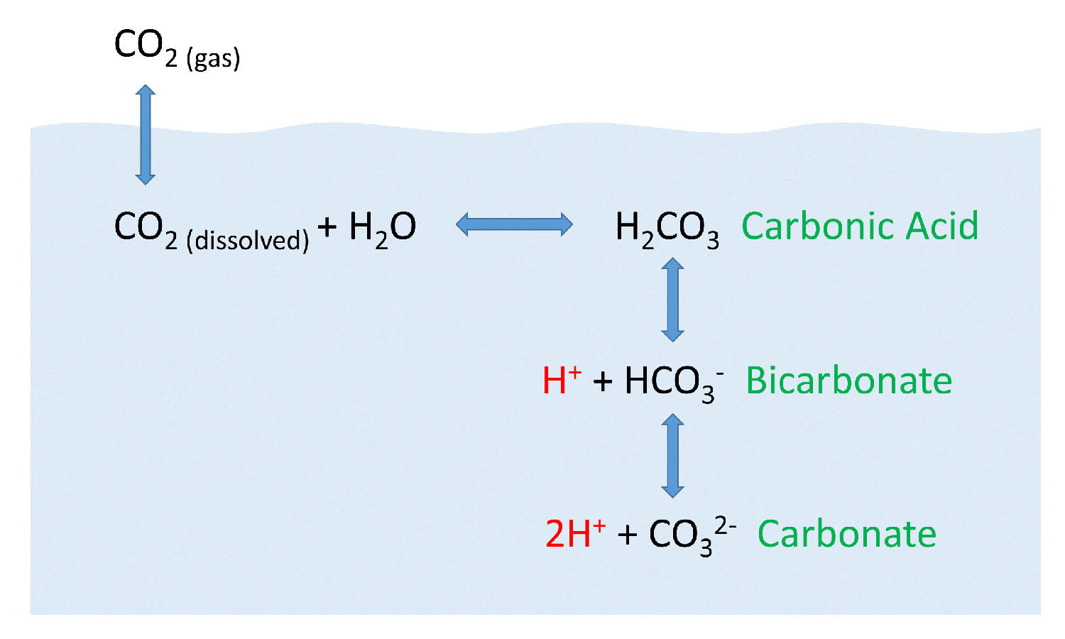
Why is carbon dioxide the issue?
Questions to consider:
What do you notice about the chemical reaction between carbon dioxide and water?
Which particle directly influences the pH of the ocean?
Which particle do you think is used by shelled animals (such as the pteropod)? Hint: their shells are made of a material called “calcium carbonate”.
Notes:
Teacher Background:
When CO₂ gas dissolves in the ocean, it interacts with the water to produce a number of different compounds according to the reaction on the slide.
CO₂ reacts with water to produce carbonic acid (H₂CO₃), which then dissociates into bicarbonate (HCO^{3–}) and hydrogen ions (H+). The bicarbonate ions can further dissociate into carbonate (CO₃²⁻) and additional hydrogen ions. In this equation, the pH of the ocean is regulated and conditions remain favorable for life.
The video on the next slide will provide background information as to why it is important to mitigate the root cause of climate change (carbon emissions). You may introduce the term “mitigation” as a term for reducing climate change, which involves reducing the flow of heat-trapping greenhouse gases into the atmosphere. (Read more about mitigation vs adaptation methods here: https://climate.nasa.gov/solutions/adaptation-mitigation/ )
Teacher Guidance:
Remind students that the climate data from the previous day showed important trends regarding the rampant increase of CO₂ in the atmosphere. To see how this change on Earth affects the ocean, students will make sense of the chemical reaction involved in ocean acidification to understand why the mitigation of carbon emissions is so important.
In partners, they will answer the questions to consider. They will write their responses on the student handout.
Students will share their initial ideas with a partner. They will revise their answers after watching the video on the next slide.
Image Credit Roger William University

Slide 26
Ocean Acidification:
Changing the Chemistry of the Ocean
Notes:
Teacher Background:
The video will provide background information as to why it is important to mitigate the root cause of climate change (carbon emissions). It will also go in depth of the equation between CO₂ and water, and the effects on shelled organisms.
Details on the chemistry behind ocean acidification: When oceans absorb atmospheric CO₂, some of it will remain dissolved in a gaseous state but most will be chemically modified.
Carbon dioxide will combine with water to form carbonic acid, which dissociates into hydrogen ions and hydrogen carbonate
H⁺ ions will lower the ocean pH (acidification) and will also combine with free carbonate ions to form more hydrogen carbonate
With less free carbonate ions in the water, marine organisms are less able to produce calcium carbonate (via calcification)
Calcium carbonate is used to form the hard exoskeleton of coral and is also present in the shelled animals
Hence increasing concentrations of dissolved carbon dioxide threatens the viability of coral reefs and shelled animals
More information: Ocean–Atmosphere Carbon Dioxide Exchange
Teacher Guidance:
Students will revise their answers from the previous slide based on the video.
What do you notice about the chemical reaction between carbon dioxide and water? CO₂ reacts with water to produce carbonic acid (H₂CO₃)
Which particle directly influences the pH of the ocean? Hydrogen ions (H+)
Which particle do you think is used by shelled animals (such as the pteropod)? Hint: their shells are made of a material called “calcium carbonate”. Carbonate ions (CO₃²⁻)
After watching the video, students will answer the following question on their handout: “If this equation represents the process in which pH of the ocean is regulated, describe how ocean acidification is disrupting the balance.” They may re-write the chemical equation and show changes or create another model that represents their thinking. H+ ions will lower the ocean pH (acidification) and will also combine with free carbonate ions to form more hydrogen carbonate. With less free carbonate ions in the water, marine organisms are less able to produce calcium carbonate (via calcification).

Slide 27
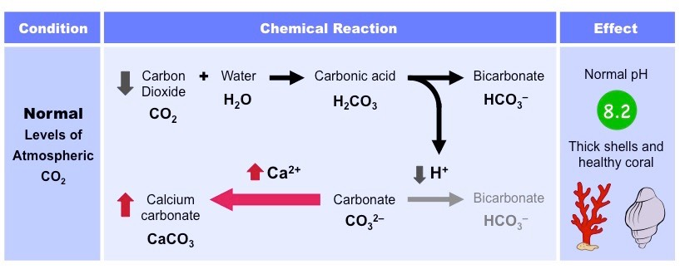
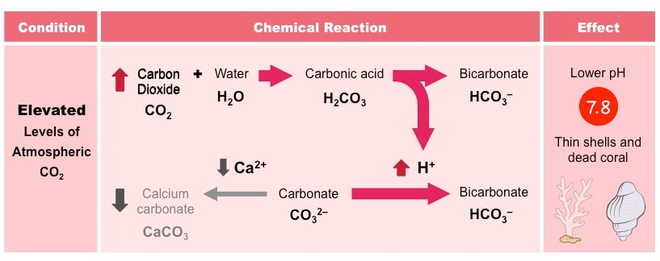
Word Bank:
Calcium carbonate
Carbonic acid
Carbon dioxide
H+ (hydrogen ion)
A
B
C
D
A
B
C
D
Notes:
Extra review (optional)
Teacher Guidance:
Students will fill in the boxes using the word bank. Students will work in pairs and walk through each chemical reaction, describing what happens to the ocean and organisms under each condition (normal levels of atmospheric CO₂ and elevated levels).
The gray boxes will fade away (on click animations).
Image Credit: Ocean–Atmosphere Carbon Dioxide Exchange

Slide 28
Based on what you know about OA, what do you think the artist is trying to convey here?
What could this art be inspiring us to do?
Notes:
Teacher Background:
Now that students have an understanding of the cause and effects of ocean acidification, students will see how art can also convey and inspire solutions to climate change. They will consider how their art can also convey and inspire meaning to an audience.
Pathways for Reducing Emissions by Alisa Singer. It is based off a graph that shows possible scenarios of levels required to reduce global greenhouse gas emissions sufficiently to limit global mean temperature rise in the post-industrial era to not more than 2 degrees Centigrade (3.6 degrees Fahrenheit).
Teacher Guidance:
Provide each group of 3-4 students with a copy of just the artwork. They may also look at the previous two images to piece together a story. (Link)
Give students a quick 3 minutes to brainstorm what they think the artist is trying to convey. Students will write their ideas on the handout under “Art inspired by climate change (Image 3)”
What do you think the artist is trying to tell you? Students may begin to piece together the big idea that scientists are focused on decreasing CO₂ emissions. There is a downward slope or pattern in this art, similar to the first graph from Lesson 1.
How do you think the artist felt while creating this digital art? Why do you think that?
Ask each group to share one thought they had about the artwork and the artist.

Slide 29
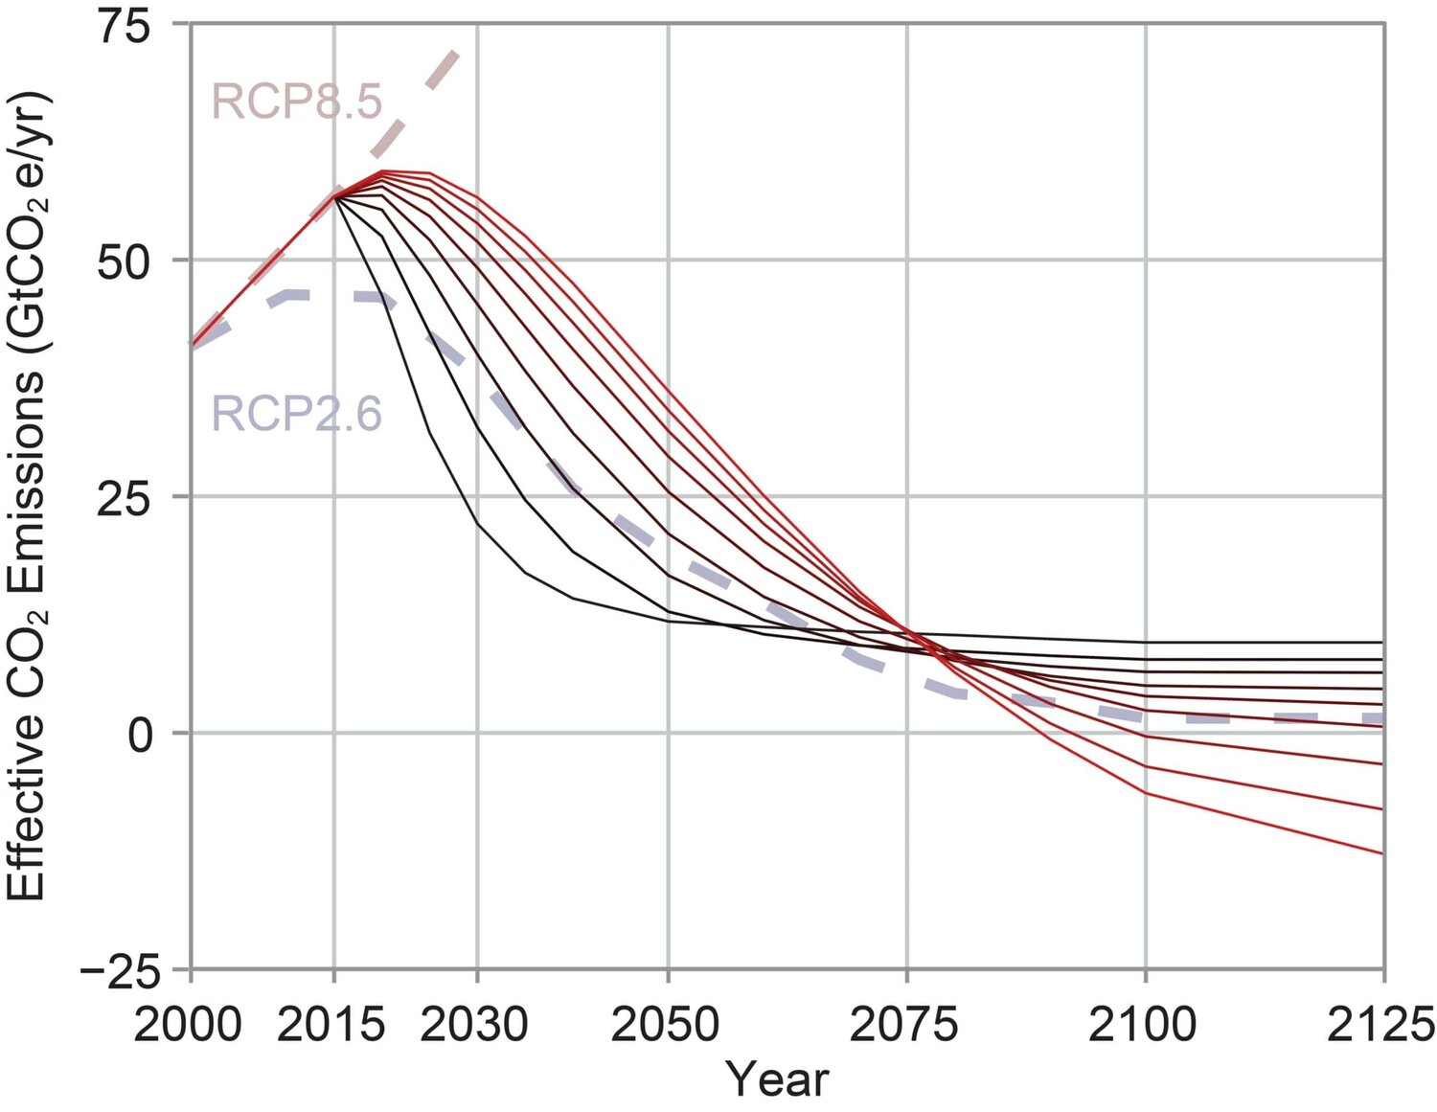
Art Inspired by Climate Change
Pathways for Reducing Emissions
Notes:
Teacher Background:
Remind students that the graph on the right side represents how scientists communicate and present data. Notice that over the past few days, they have been able to create art that holds a deeper meaning, but it is also still based off climate data. As they make edits to their art, it is important to consider how the everyday person can still engage with their work without being a scientist.
This graph represents the various projected “pathways” in which Earth will experience a certain concentration of emitted CO₂ in a given year and over time. RCP stands for “Representative Concentration Pathways”. These values are dependent on humanity’s efforts to curb carbon emissions. For example, following the RCP 2.6 pathway means that the efforts to curb carbon emissions is high (emitted CO₂ is low). RCP 8.5 represents the pathway in which efforts are low (emitted CO₂ is high). CoastAdapt
This information is important because addressing climate change is dependent on mitigating carbon emissions, the root cause of climate change and ocean acidification.
RCP values are similar to the SSP values from Lesson 1 (Various SSP values → The amount of global warming that will be experienced by the planet will depend on how quickly humans curb CO₂ emissions). The big idea is for students to see that scientists use current data to make predictions (projections) about future climate conditions. It is not dependent on one person or certain people, but the collective efforts of the global community.
Teacher Guidance:
Pass out the Data for Image #3 for to each group. Students will see the piece of art side-by-side with the climate science data that inspired it. With a partner, students will first read the graph. Students can fill in the title of the art, “Pathways for Reducing Emissions” and write their observations (under “What I notice”) on the student handout. Students may observe:
X-axis = Time
Y-axis = Effective CO₂ emissions (in Gigatonnes of CO₂ emissions per year)
Various RCP values (dotted lines)
The black curves reflect the fastest reduction scenarios, resulting in the least need for future negative emissions. The red curves show a slower response, requiring much deeper levels of future negative emissions.
Students can then interpret the graph. Pose the following questions to check for understanding. Students will answer the questions on the handout.
RCP stands for “Representative Concentration Pathways”. Think back to the “SSP values” from Lesson 1. How are those values similar to RCP values? What do you think dictates the RCP patterns? SSP values represent the amount of global warming that will be experienced by the planet will depend on how quickly humans curb CO2 emissions. RCP values represent the amount of carbon emissions based on the same idea: human behavior.
Why do you think this information is important? Scientists can use the RCPs to make predictions of how concentrations of greenhouse gases in the atmosphere will change in the future as a result of human activities. It can guide policies and regulations when it comes to mitigating CO₂ emissions.
Students will make connections back to the ocean. Pose the following question to elicit student ideas:
How does this information relate to ocean acidification?
What type of efforts must be made mitigate, or reducing severity, or carbon emissions?

Slide 30
Continue exploring ocean acidification and art inspired by climate change.
Notes:
Teacher Background:
The Ocean Agency Ocean Acidification Toolkit
Toolkit screenshots
PDF to print
Now that students have a shared understanding of the causes and effects of ocean acidification, they will continue to deepen their understanding toward the topic of their choice from the Ocean Acidification toolkit. Turn their attention to the solutions the toolkit presents, which they will learn more about in the next lesson.
Students may need support in finding data that supports the message they are trying to convey in their art. Provide the link to the full website of Alisa Singer’s Environmental Graphiti art: https://eg-v2.squarespace.com/series-folder
Teacher Guidance:
Students will continue to explore the online toolkit OR read through the printed PDF. If students have access to internet, they may conduct further research beyond The Ocean Agency toolkit.
To guide students in deepening their understand of ocean acidification and how they might reimagine their art, consider posing the following questions to guide their thinking. Students can write their thoughts on their handout.
What are you thinking or feeling now about ocean acidification?
What type of solutions does the toolkit suggest to respond to the issue of ocean acidification?
How might this inspire changes in your artwork? How does this affect the imagery, icons, or patterns you have used to center your artwork?
What questions do you still have about your topic? What kind of data might you be interested in looking at to deepen your understanding of your topic?

Slide 31
How does the ocean serve as climate’s heart and what are the ways that we can advocate for the health of the ocean?
Notes:
Teacher Background:
Reminder note: Just as a heart circulates blood and regulates the body’s temperature, the ocean regulates climate through the circulation of heat, moisture, and carbon, throughout Earth’s system. (NNOCCI Climate’s Heart)
Teacher Guidance:
Students will revisit the investigative phenomenon question. Students will discuss in pairs the big ideas from Lesson 1 and 2 so far and what have they learned so far to address the question. Their answers may sound like:
Lesson 1 - Climate change is changing the chemistry of the ocean. The ocean is climate’s heart.
Lesson 2 - The ocean is absorbing carbon dioxide which regulates the heat in the atmosphere, but it is harming marine life in multiple ways (TOA toolkit)
Lesson 3 - When oceans absorb atmospheric CO₂, some of it will remain dissolved in a gaseous state but the free Hydrogen ions (H+) in the chemical reaction causes the acidification of ocean waters as well as inhibits the growth of shell-based animals.
Review any of the key terms that might have been mentioned in Lesson 1 and how it relates to ocean acidification:
Weather or climate
Climate change
Greenhouse gasses or Carbon emissions or Carbon dioxide
Human impact
Animals (coral reefs, shelled animals)

Slide 32
How can you creatively communicate through art?
Time to edit!
Revisit your art. Keep in mind: How do YOU want to convey what you see, hear, or feel about ocean acidification?
What resonated with you as you explored the toolkit? What imagery, icons, or patterns can you integrate into your art?
As you learn something new every day, you will add or modify your art!
Notes:
Investigative Phenomenon: How does the ocean serve as climate’s heart and what are the ways that we can advocate for the health of the ocean?
Teacher Background:
At this point, students should be considering how their art can creatively convey a powerful message about solutions for ocean acidification. They have done more research on their topic, looked at more examples of Alisa Singer’s art, and seen some solutions presented in the toolkit.
Teacher Guidance:
Students will revisit their art and consider how they interpreted Alisa Singer’s art, what they learned about the chemical reaction for ocean acidification, and new information that resonated with them from the TOA toolkit.
Students will adjust their art by refining the way they aim to convey their newfound knowledge, thoughts, and feelings toward ocean acidification. Make edits in pencil only for now.
Since students are creating various forms of art, consider posing the following questions to elicit ideas on how to embed reducing carbon emissions in their work:
If you are creating a drawing or painting, what symbols or patterns can depict solutions for ocean acidification?
If you are writing a song, poem, or story, what words or phrases can you use to describe solutions for ocean acidification?

Slide 33
Homework: Lesson 3 Journal Entry
How did your art change today?
What was your reasoning for the changes?
Describe in detail how your art changed.
How did the information from today’s lesson influence your art?
Notes:
Teacher Guidance:
Students will fill in Lesson 3 in their Creative Journal. They will describe the changes they made to their art and provide an explanation for their changes. Encourage students to reflect on how they are communicating the information they learned that day.

Slide 34
Notes:
This slide is intentionally left blank.

Slide 35
Lesson 4
The Ocean as Climate’s Heart
Solutions for a climate reimagined
Notes:
Lesson 4
Investigative Phenomenon: How does the ocean serve as climate’s heart and what are the ways that we can advocate for the health of the ocean?
Teacher Preview:
Students will be introduced to the Global Carbon Budget as the last piece of art they interpret.
Students will learn about real solutions to decrease/eliminate carbon emissions in their own personal lives and complete a Frayer Model and share out as a jigsaw activity.
Their only homework will be to complete Day 4 in their Creative Journals.

Slide 36
Art Inspired by Climate Change
Global Carbon Budget
Notes:
Teacher Background:
This graph introduces the carbon budget, an estimate of the maximum amount of greenhouse gases that can be released into the atmosphere over time and still keep warming below 2° C (compared with the beginning of the Industrial Age in the 18th Century).
Teacher Guidance:
Now that students understand that art can convey powerful messages as well as the need to reduce carbon emissions, go straight into looking at the next piece of art side-by-side with the Global Carbon Budget graph. Pass out the art and data for Image #4. Provide printed copies (Link).
Students discuss similarities of this graph to previous images they have seen with a partner. Students can write their thoughts on the handout. Pose the following question to elicit student ideas:
What do you think it means by the Earth having a “carbon budget”?
What do the different colored lines represent? RCP pathways as seen in the previous image
What type of efforts must be made to mitigate, or reduce severity, or carbon emissions? How will that impact the ocean?

Slide 37
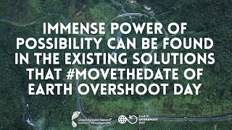
What does the carbon budget tell us?
Earth Overshoot Day
Earth Overshoot Day marks the date when humanity’s demand for ecological resources and services in a given year exceeds what Earth can regenerate in that year. We maintain this deficit by eliminating the accumulating waste, primarily carbon dioxide in the atmosphere.
Notes:
Teacher Background:
There are many solutions to mitigating carbon emissions. One initiative is called Earth Overshoot Day: it is hosted and calculated by Global Footprint Network, an international research organization that provides decision-makers with a menu of tools to help the human economy operate within Earth’s ecological limits (GFN). Show this video to instill hope and provide an insight to solutions as students continue to learn more about their chosen topic from The Ocean Agency Ocean Acidification toolkit. One take-away from this video is that the solutions presented require both an individual and collective effort to mitigate climate change.

Slide 38
Notes:
Teacher Background:
Remind students of The Ocean Agency Ocean Acidification Toolkit they explored has solutions listed on the page.
Show students a screenshot of the toolkit showing reducing fossil fuels as the first solution listed as a way to solve ocean acidification.

Slide 39
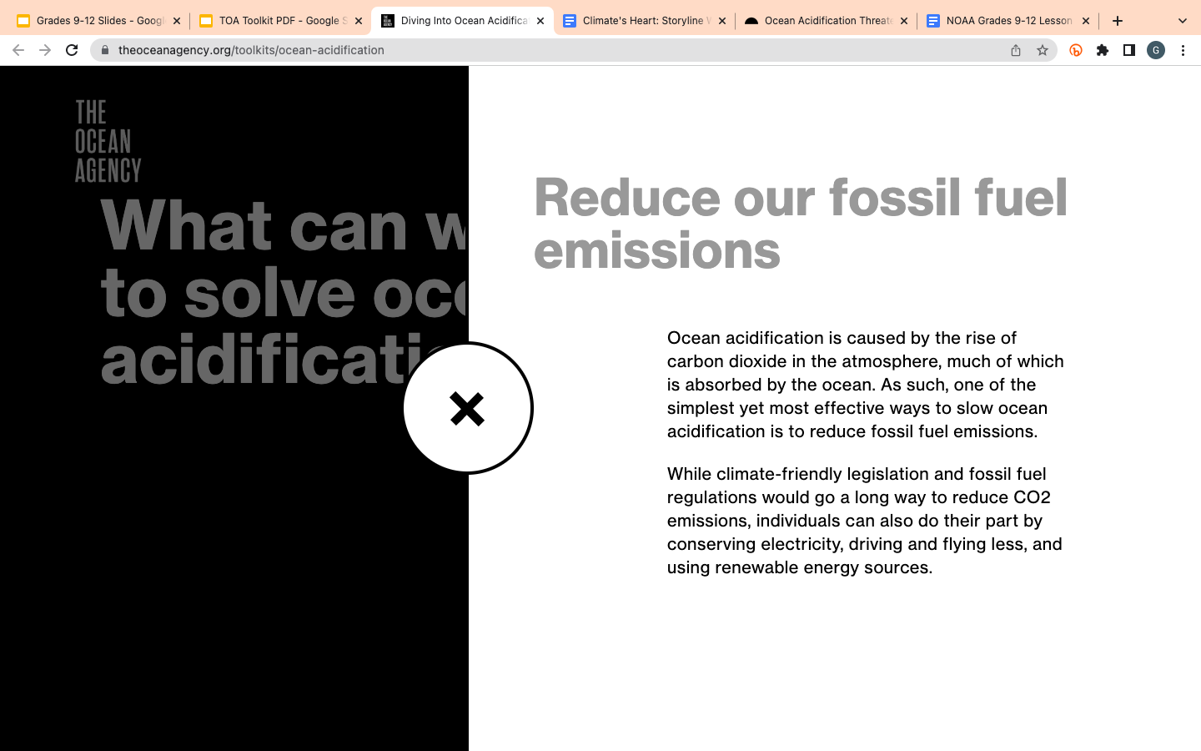
Notes:
Teacher Background:
Show students a screenshot of the toolkit showing what the “Learn More” link leads to. Since the information only scratches the surface, the next activity will provide additional specific solutions on how to reduce fossil fuel emissions.

Slide 40
How does the solution address climate change and carbon emissions (including fossil fuel)? | Diagram with labels and captions
What is an example of this solution in action? Describe how it can be done on the individual and community level. | What is one question you still have after reading about this solution?
Solution
(Planet, Cities, Energy, Food)
Notes:
Teacher Background:
This activity provides specific solutions to reducing or eliminating global carbon emissions. Although the Overshoot Day Solutions Website also has a “Population” topic, the four listed are recommended to explore (Planet, Cities, Energy, Food). The Population tab delves into more complex social and economic topics (it can serve as an extension).
This activity also highlights the importance of solutions being scalable and starting at the individual level and expanding the efforts on a collective front. Furthermore, there are equity and accessibility issues when putting the weight on the individual, since not everyone can contribute the same way or amount.
The Frayer Model allows students to explore a solution in a guided protocol.
For the jigsaw, students in a group of 3-4 will each have a solution they want to learn more about (or assigned by the teacher). The solutions are found on the Overshoot Day Solutions page. Then they will meet with all other students who have that same solution (e.g. all students studying Planet solutions will meet in a designated area in the class). They will spend about 10 minutes working in their jigsaw groups and filling out the Frayer Model. They will collaborate on their answers so that when they return to their original group of 3-4, their information the class as a whole will be consistent. Students become experts in one solution and will hear major takeaways from other solutions.
Teacher Guidance:
Students will do a jigsaw activity in groups of 3-4. Each students will become knowledgeable about their solution(s) and share it with the other group members. They will fill out the Frayer model on their handout based on their solution. After everyone in the group has finished, students share their findings and fill in their worksheet with “main takeaway points” for each solution.
If needed, provide printed copies of each category
Earth Overshoot Day Solutions PDF
Website credit: https://www.overshootday.org/solutions/

Slide 41
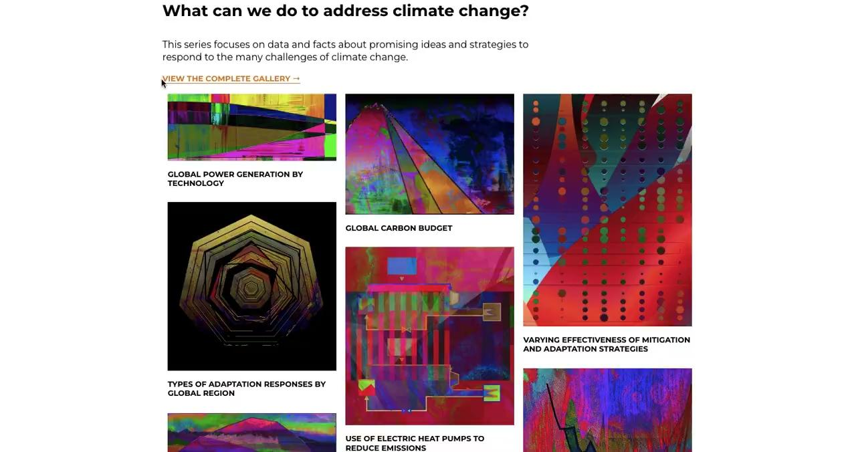
Environmental Graphiti
What can we do to address climate change?
Notes:
Teacher Guidance:
If a student finishes their Frayer Model early, encourage them to look through the online gallery of “What can we do to address climate change?” As they look through the rest of her art, they can walk through the same protocol done in class:
What do you think the artist is trying to tell you?
How do you think the artist felt while creating this digital art? Why do you think that?

Slide 42
How does the ocean serve as climate’s heart and what are the ways that we can advocate for the health of the ocean?
Notes:
Teacher Background:
Reminder note: Just as a heart circulates blood and regulates the body’s temperature, the ocean regulates climate through the circulation of heat, moisture, and carbon, throughout Earth’s system. (NNOCCI Climate’s Heart)
Teacher Guidance:
Students will revisit the investigative phenomenon question. Students will discuss in pairs the big ideas from each day and how it addresses the question, specifically the second part of the question. Their answers may sound like:
Lesson 1 - Climate change is changing the chemistry of the ocean. The ocean is climate’s heart.
Lesson 2 - The ocean is absorbing carbon dioxide which regulates the heat in the atmosphere, but it is harming marine life in multiple ways (TOA toolkit)
Lesson 3 - When oceans absorb atmospheric CO₂, some of it will remain dissolved in a gaseous state but most will be chemically modified.
Lesson 4 - There are solutions to mitigate carbon emissions and therefore regulate the health of the ocean and prevent ocean acidification.

Slide 43
Homework: Lesson 4 Journal Entry
How do you plan to finalize your art?
What is the reasoning for the changes?
Describe in detail how your art will change. Consider the materials available.
How did the information from today’s lesson influence your art?
Notes:
Teacher Guidance:
Students will fill in Lesson 4 in their Creative Journal. They will consider how they will finalize their art on the last day of the lesson.

Slide 44
Notes:
This slide is intentionally left blank.

Slide 45
Lesson 5
The Ocean as Climate’s Heart
Inspiring Community Action
Notes:
Lesson 5
Investigative Phenomenon: How does the ocean serve as climate’s heart and what are the ways that we can advocate for the health of the ocean?
Teacher Preview:
Students will receive feedback on their art from conducting another Glow and Grow conversation.
Students will finalize their art and consider how their artwork will move collective action.
Their homework will be to complete Day 5 in their Creative Journals.

Slide 46
Feedback
Conduct another “Glow and Grow” conversation with a partner! Keep in mind this is the last time you’ll receive feedback.
bit.ly/GLOWANDGROWTALK
Notes:
Teacher Background:
Reminder students: It is important to tell students that they have the opportunity to accept the feedback given or respectfully reject feedback. Students should know that they have to listen to the feedback of their classmate, but they are not obligated to follow the advice. The final choice is always theirs. (Art of Education)
Teacher Guidance:
Provide printed copies of the Glow and Grow protocol or project the bit.ly on the screen so students can access the PDF on their own device.
Students will engage in the feedback activity with a partner. They can record any notes on the student handout and apply any changes to their art on the final day of the lesson series.
Image Credit Art of Education

Slide 47
How can you creatively communicate through art?
How will your creative communication move collective community action?
It’s time to FINALIZE your art.
Keep in mind: How do YOU want to convey what you see, hear, or feel about ocean acidification? How can your art advocate for the health of the ocean?
Notes:
Investigative Phenomenon: How does the ocean serve as climate’s heart and what are the ways that we can advocate for the health of the ocean?
Teacher Background:
Students should be finalizing how their art can creatively convey a powerful message about ocean acidification and ways they can advocate for a healthy climate and ocean.
Teacher Guidance:
Students will finalize their art and consider how their art can reach a wider audience. The goal is for people to understand that fighting climate change is a collective effort. Students will adjust their art such that it clearly conveys their newfound knowledge, thoughts, and feelings toward ocean acidification. Students will now add color (if applicable) to their art.
Students have the option to keep their art as is (with all their edits) or create a final draft. If students wanted to create digital art or a physical piece, support them as needed.
Since students are creating various forms of art, consider posing the following questions to elicit ideas on how to inspire collective action in their work:
If you are creating a drawing or painting, how will you refine the symbols, patterns, and colors to inspire action to a wider audience?
If you are writing a song, poem, or story, how will you refine your words or phrases to inspire action to a wider audience?

Slide 48
Campaign Call
It’s time to put your art in action!
Notes:
Teacher Background:
If possible, work with the school library to display student’s artwork. If that is not an option, display it in your classroom and invite other classes, teachers, and administrators to observe the artwork. Encourage visitors to interpret the artwork similar to how the students did with Alisa Singer’s work.
Teacher Guidance:
Students can attach a QR code of The Ocean Agency Ocean Acidification toolkit
Toolkit screenshots
PDF to print
QR Code
Once all the artwork is posted, students will conduct a gallery walk where they visit their peers’ work but look at at least 5 pieces in depth, so they may reflect on them in their last entry for their Creative Journal.

Slide 49
Homework: Lesson 5 Journal Entry
How do you feel about your final piece?
What do you notice about your peer’s artwork?
Describe in detail how your art changed over the course of the last five days.
After looking at what your peers created, reflect on what stood out to you or what questions you still have.
Notes:
Teacher Guidance:
Students will fill in Lesson 5 in their Creative Journal. They will describe any final changes they made to their art and provide an explanation for their changes. They will also reflect on what they saw in their peers’ artwork and how they communicated information regarding the ocean and climate change.

Slide 50
Notes:
This slide is intentionally left blank.

