Slide 1
Myth-Busting Expiration Dates

Slide 2
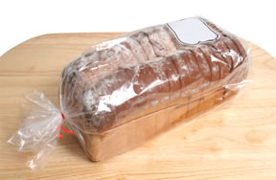
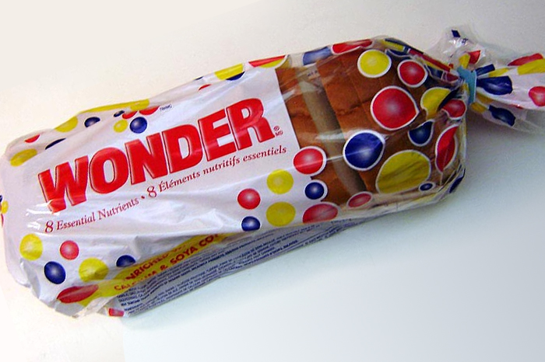
The (Food) Dating Game: Which Would You Eat?
Bread from a bakery:
Bought a week and a half ago
Store-bought bread:
Five days past best if used by date

Slide 3
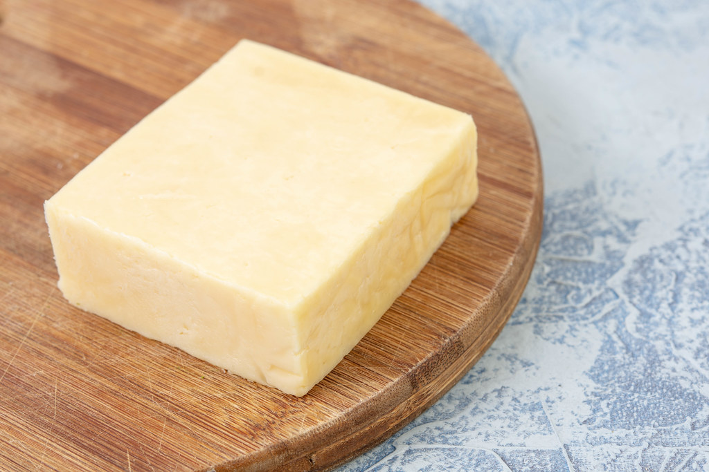
The (Food) Dating Game: Which Would You Eat?
Packaged sliced cheese:
Two weeks past best by date
Cheese without packaging:
Date unknown

Slide 4
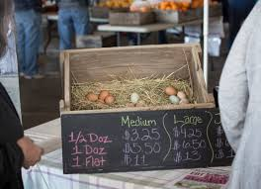
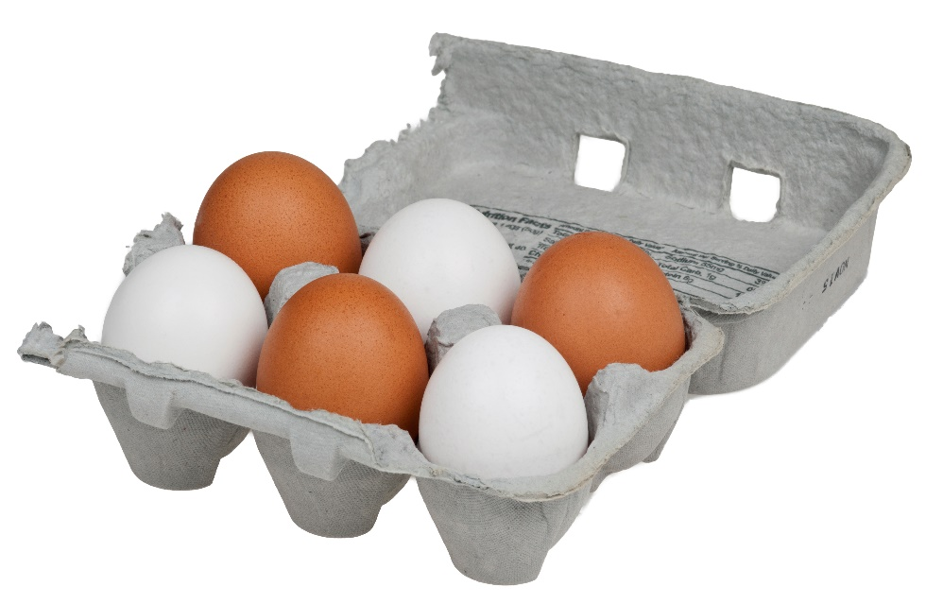
The (Food) Dating Game: Which Would You Eat?
Local farm fresh eggs:
Bought 2 weeks ago
Store bought eggs:
3 days past sell by date

Slide 5
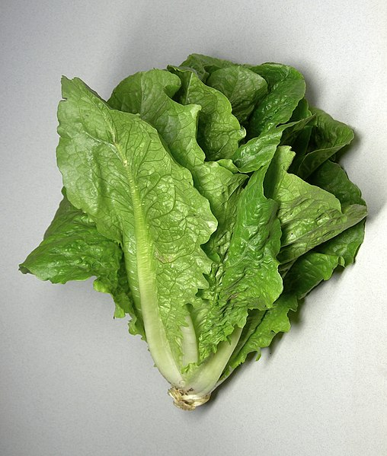
The (Food) Dating Game: Which Would You Eat?
Individual head of lettuce:
Bought a week ago from store
Packaged salad mix:
3 days past use by date

Slide 6
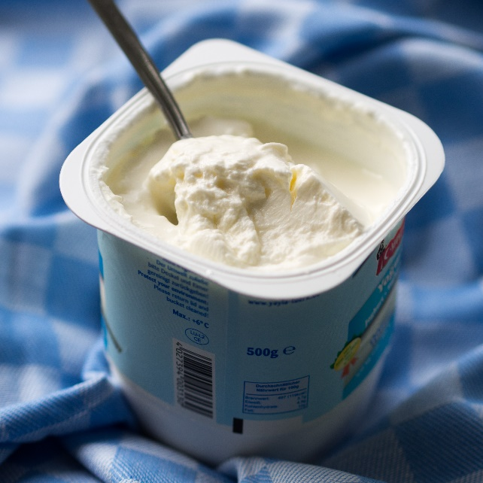
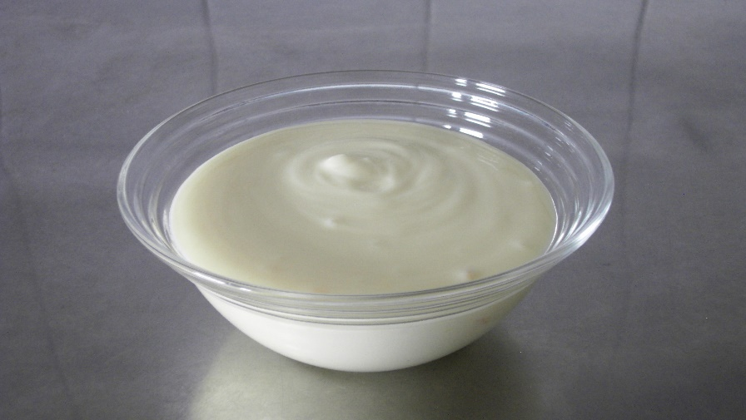
The (Food) Dating Game: Which Would You Eat?
Yogurt you packed in Tupperware for lunch, but forgot in fridge:
Four days later
Store bought individual yogurt:
A day past best by date

Slide 7
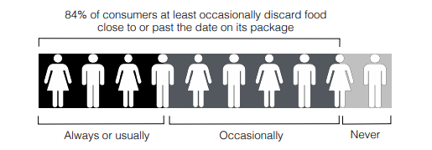
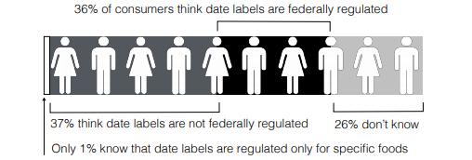
Where do you Stack Up?

Slide 8
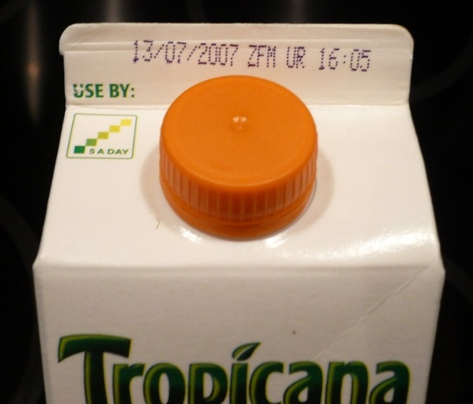
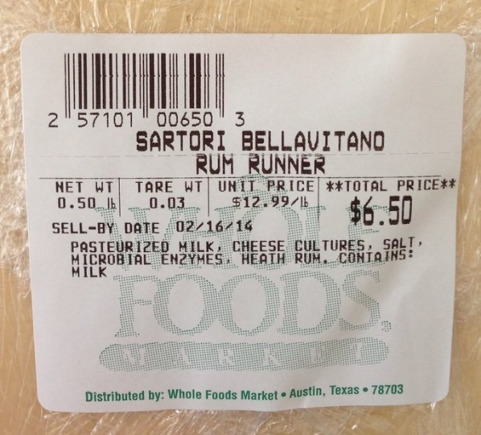
What do expiration dates actually mean?
Use-by
Best-by
Sell-by

Slide 9
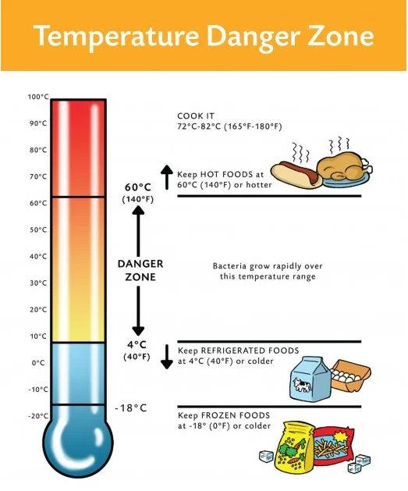
The True Expiration Date

Slide 10
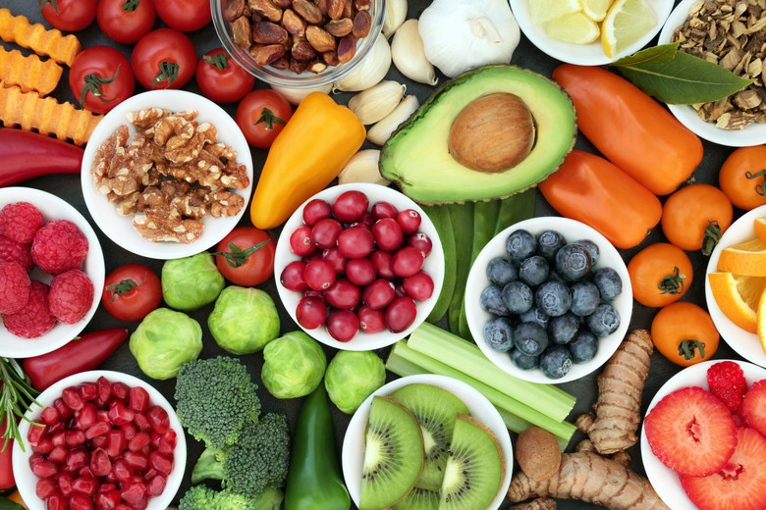
It starts at home!

