Slide 1
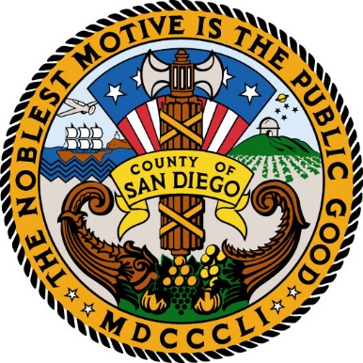
Local Food in San Diego

Slide 2
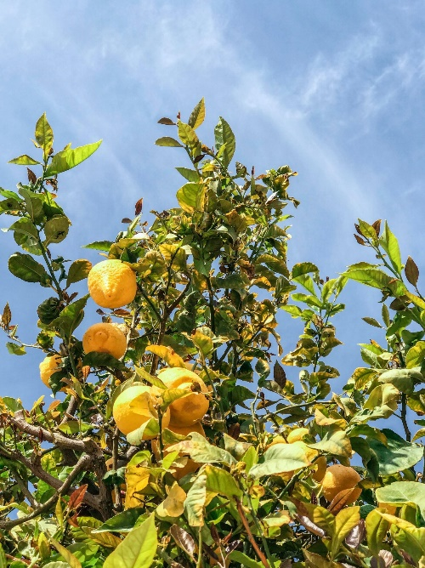
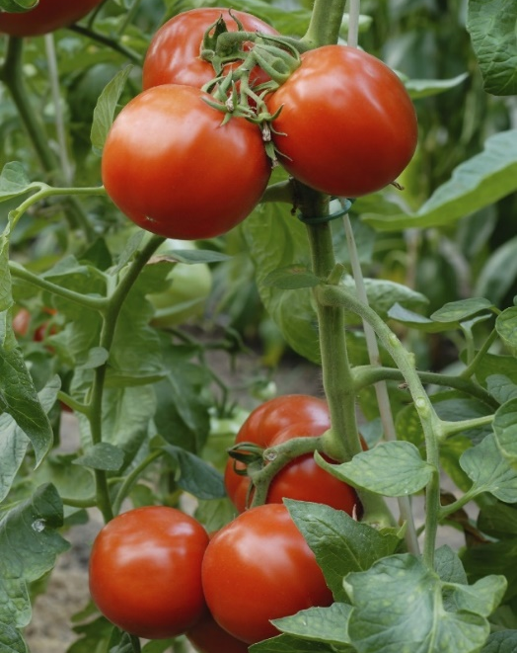
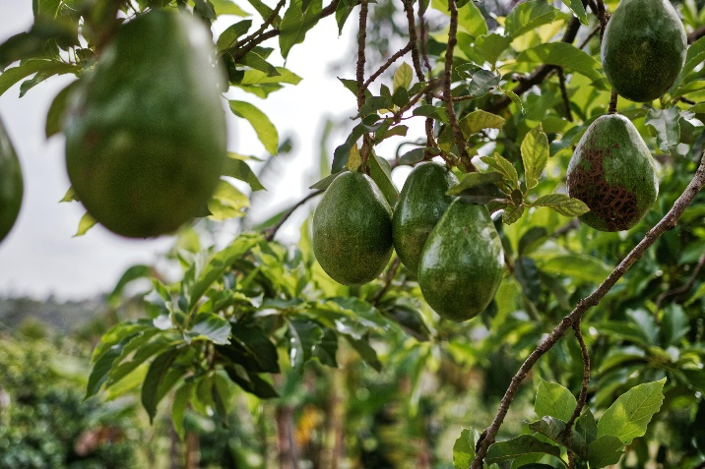
What do we grow?
#1 producer of avocados
#5 producer of lemons
#1 producer of vine-ripe tomatoes
Notes:
-40% of all avocados produced in CA come from SD County
-San Diego’s citrus industry is worth over $150 mil
-Oceanside and Camp Pendleton are home to the country’s biggest grower of vine ripe tomatoes!
Sdfarmbureau.org

Slide 3
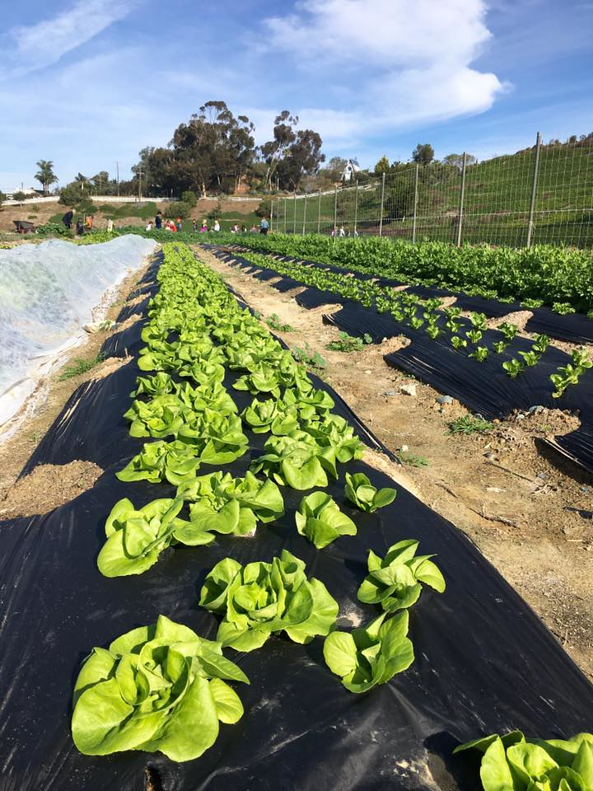
What do the farms look like?
Highest concentration of organic farms in the country
70% of county farms are between 1 and 9 acres
Notes:
-First picture is of the EUSD farm lab, which grows and provides lunches to all 9 elementary schools in Encinitas!
Sdfarmbureau.org
https://www.sandiegocounty.gov/content/dam/sdc/lueg/docs/State-of-the-Food-System-for-the-San-Diego-Region-November-2019.pdf?utm_source=Community&utm_campaign=bb24d62d5e-EMAIL_CAMPAIGN_2019_12_16_06_27&utm_medium=email&utm_term=0_cd3d37894c-bb24d62d5e-254945313&mc_cid=bb24d62d5e&mc_eid=b8ae50cf45
How organic farms are certified

Slide 4
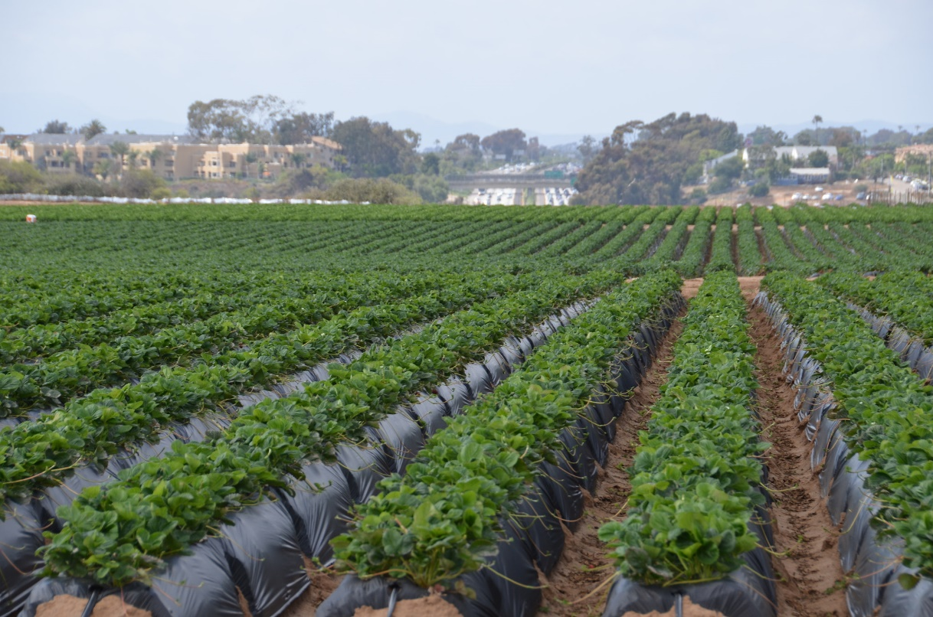
Who are the farmers?
55% of county farmers are over 50 years old
Over 35% of San Diego County farms are run by women
Notes:
-Picture is of the Strawberry fields in Carlsbad-this is a family business currently run by Jimmy Ukegawa, who is 60.
Sdfarmbureau.org
https://www.sandiegocounty.gov/content/dam/sdc/lueg/docs/State-of-the-Food-System-for-the-San-Diego-Region-November-2019.pdf?utm_source=Community&utm_campaign=bb24d62d5e-EMAIL_CAMPAIGN_2019_12_16_06_27&utm_medium=email&utm_term=0_cd3d37894c-bb24d62d5e-254945313&mc_cid=bb24d62d5e&mc_eid=b8ae50cf45

Slide 5
Video
Notes:
https://vimeo.com/181843741

