Slide 1
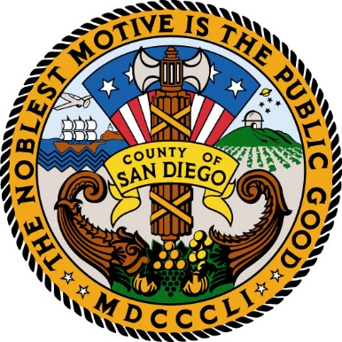
Food Donations in San Diego County

Slide 2
1 in 8 people in San Diego County are food insecure

Slide 3
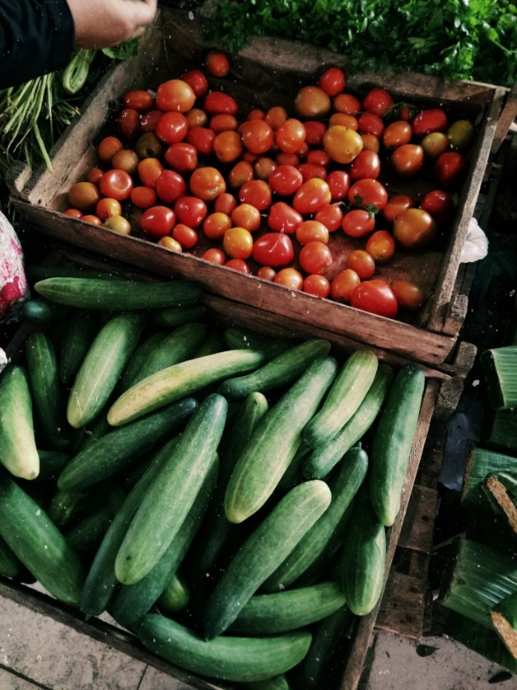
Feeding San Diego
Provides over 26 million meals every year
Run School Pantry programs at elementary schools and college campuses
Distribute food to rural areas through mobile pantry programs
Rescue usable food from corporations and retail companies
“All of the food that we need to feed everybody in San Diego County is already here every single day; it is just being wasted.” –Vince Hall, Chief Executive Officer, Feeding San Diego

Slide 4
They rescue unsold food from...

Slide 5
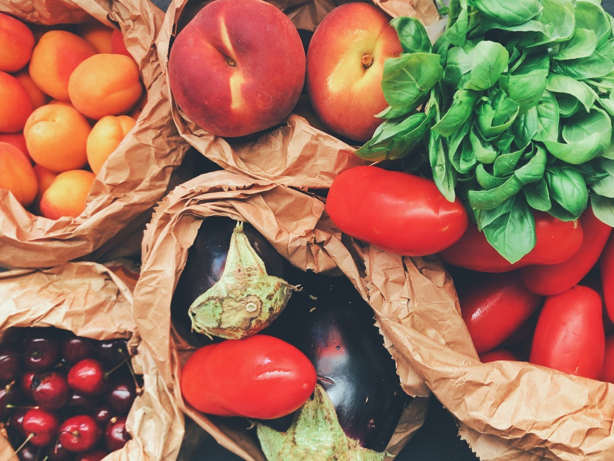
How Can You Help?
Volunteer with Feeding San Diego by packing, boxing, sorting, or cleaning food before distribution.
feedingsandiego.org

Slide 6
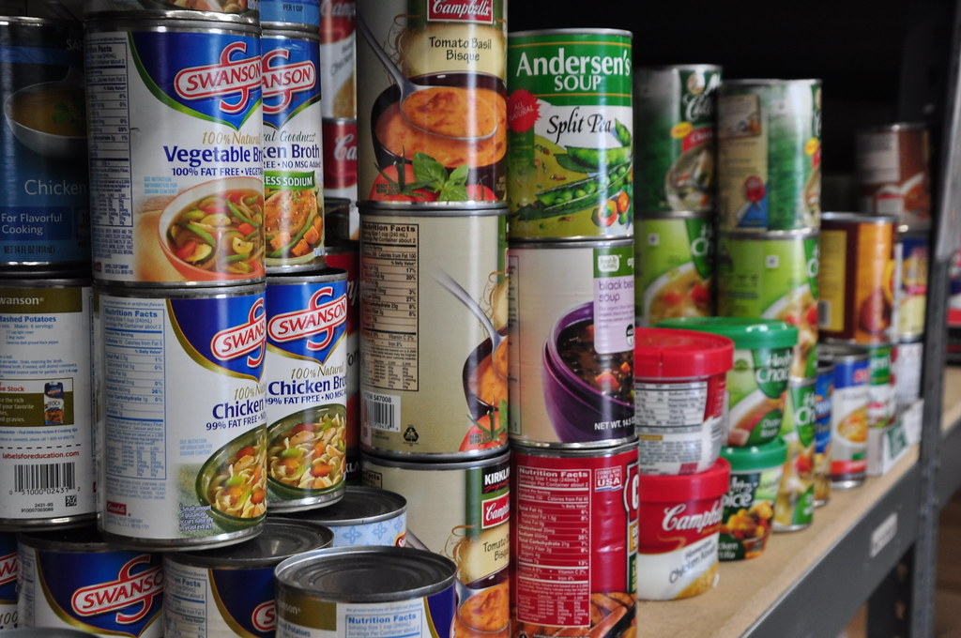
Jacobs and Cushman San Diego Food Bank
Partners with non-profits with localized distribution programs to organize food drop offs and pick ups around the county
Feeds 350,000 people every month

Slide 7
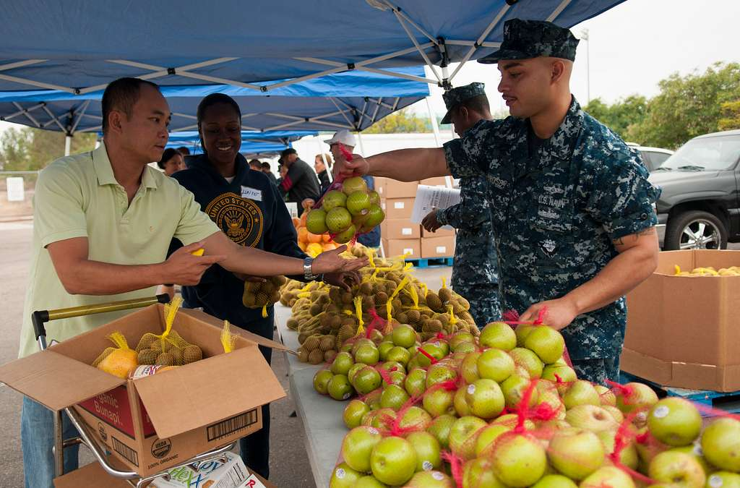
Jacobs and Cushman San Diego Food Bank
Provides emergency food assistance, neighborhood distributions, senior, and youth programs
Rescues excess prepared food from food vendors and restaurants

Slide 8
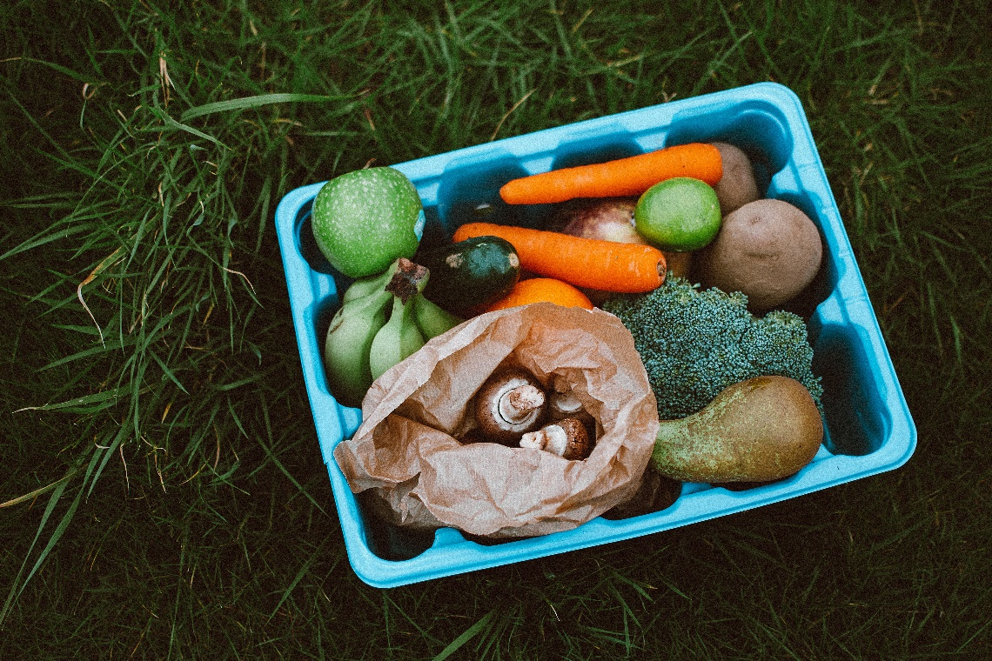
How Can You Help?
The San Diego Food Bank uses volunteers to sort and label donations, bag food for distribution, or clean fresh produce. You can also host a food drive to collect donations for the Food Bank!
sandiegofoodbank.org

Slide 9
Video

Slide 10
Be Part of the Solution!

