Slide 1
Carbon Culprits
The Relationship Between Food and Climate

Slide 2
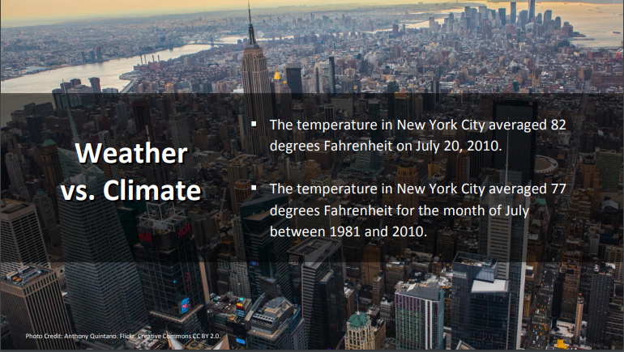
What is Climate?

Slide 3
Our Climate is Changing

Slide 4
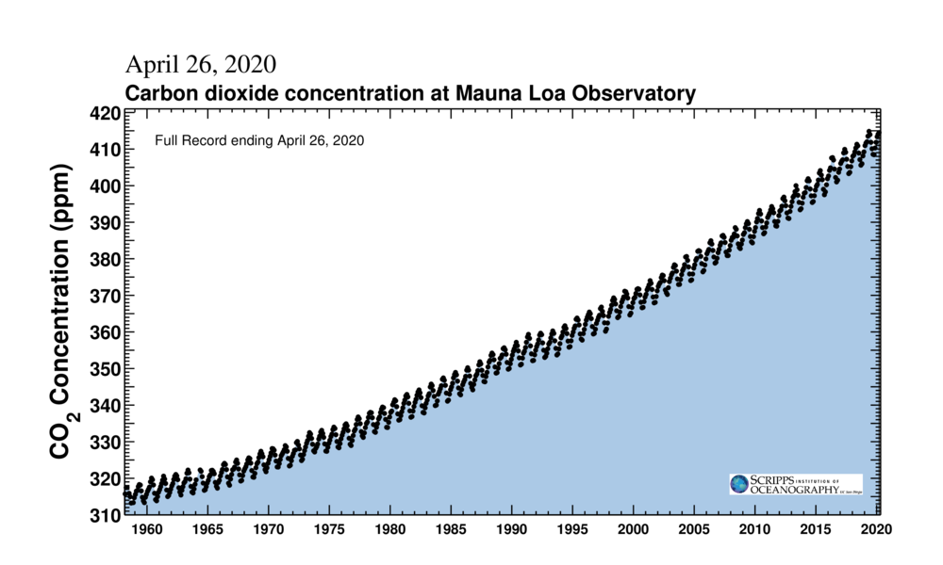
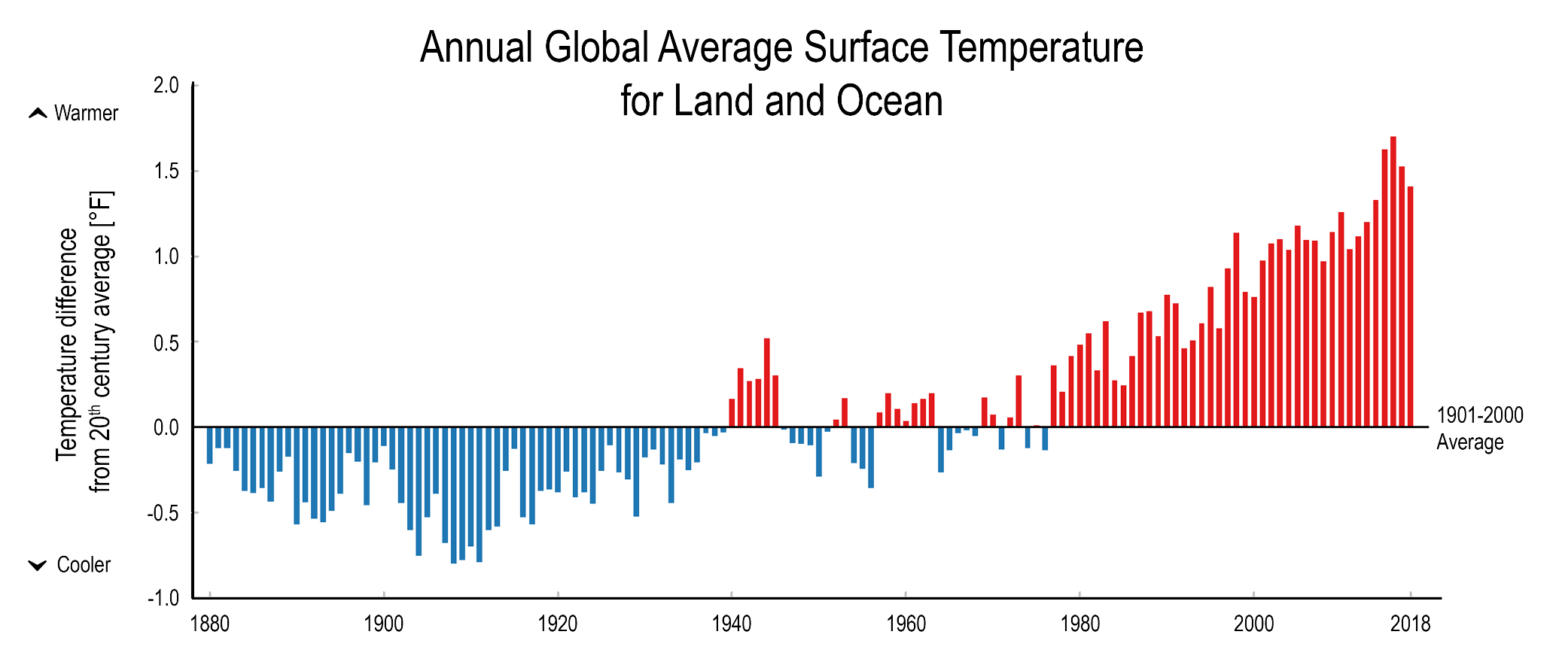
Climate Change

Slide 5
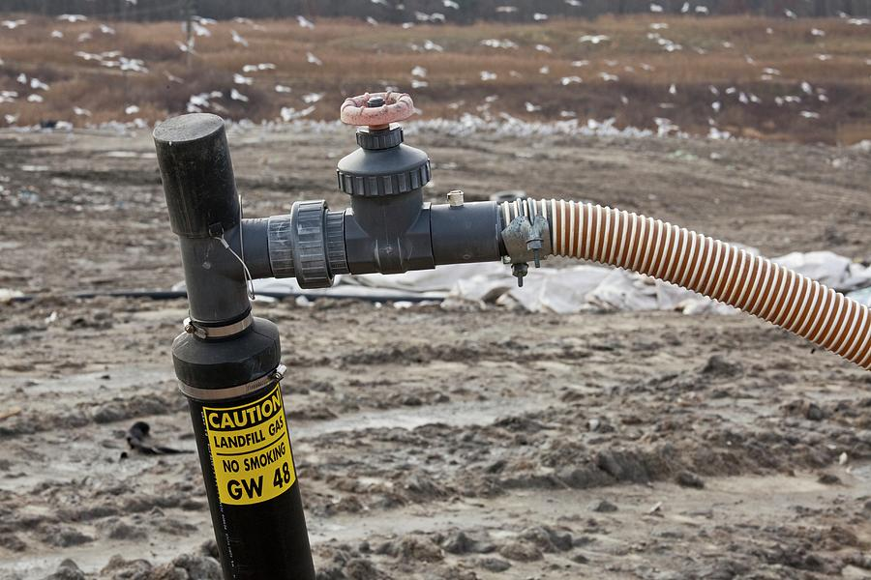
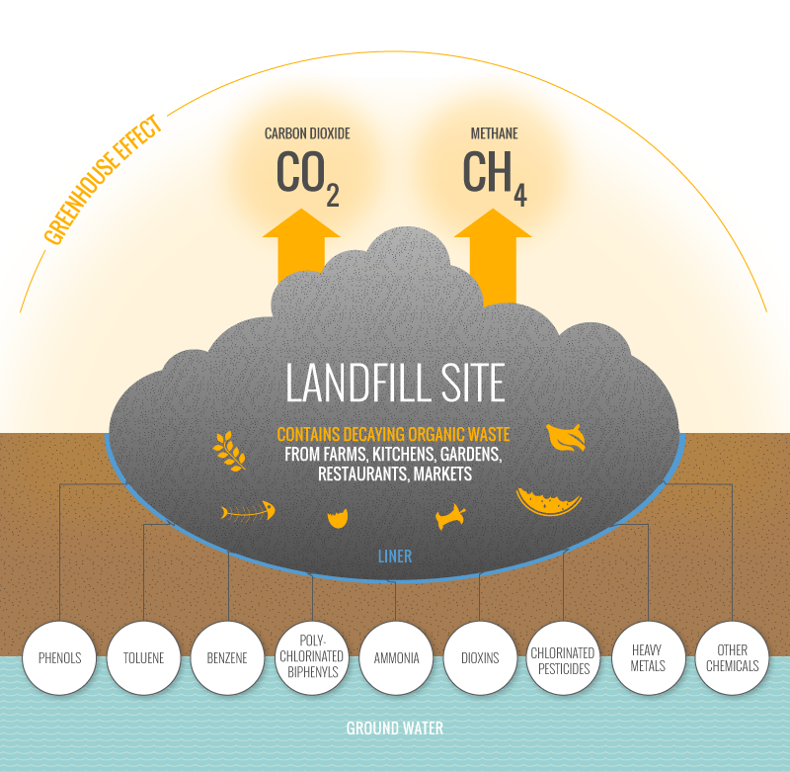
Food Waste in Landfills

Slide 6
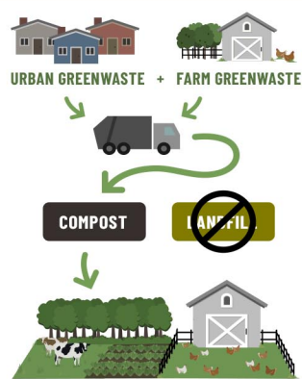
Composting

Slide 7
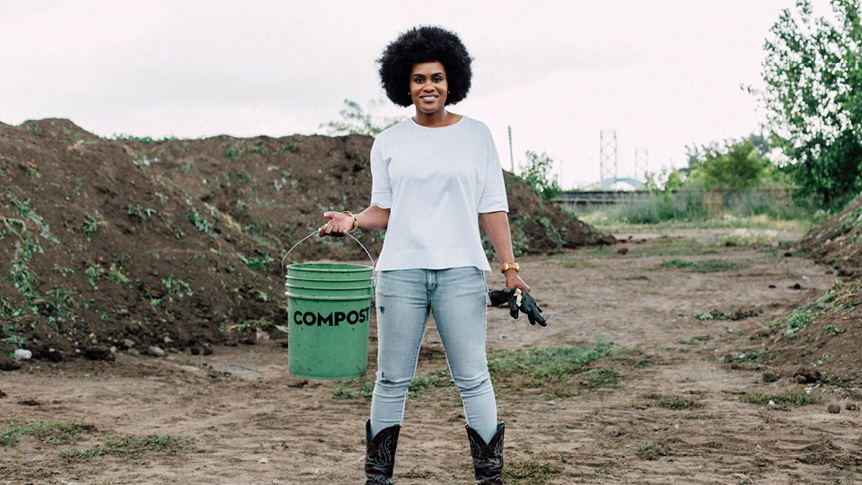
Video
Notes:
The Soil Story with Pashon Murray: https://www.youtube.com/watch?v=npu6GBbB-Oc&t=10s

Slide 8
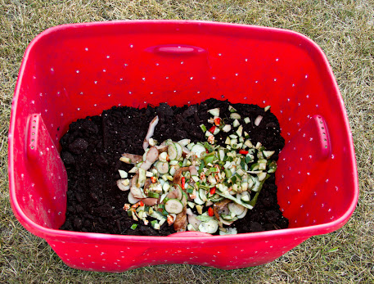
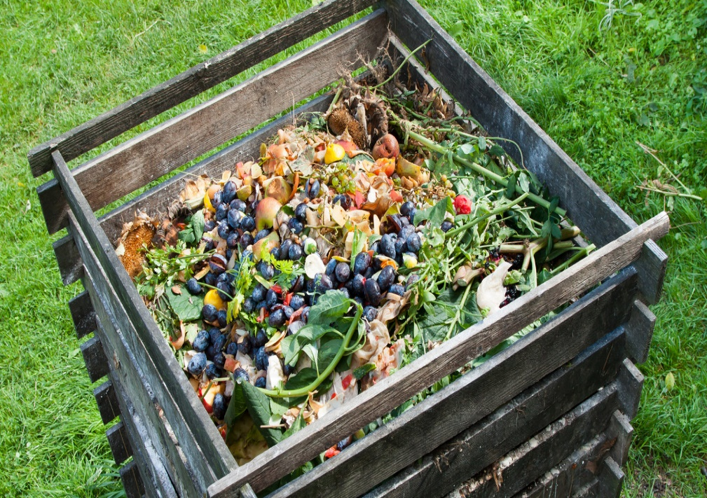
Composting at Home

Slide 9
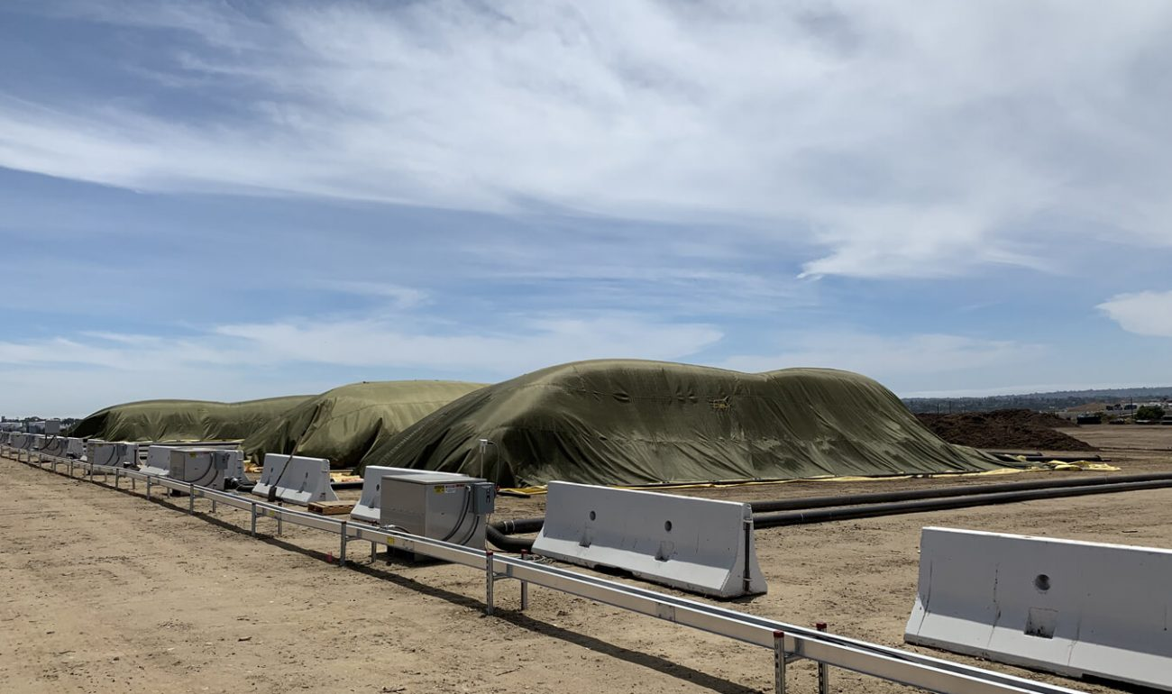
Composting at the Miramar Greenery

Slide 10
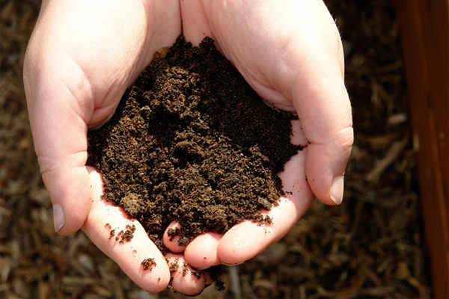
Be Part of the Solution!

