Slide 1
Agriculture in the 21st Century

Slide 2
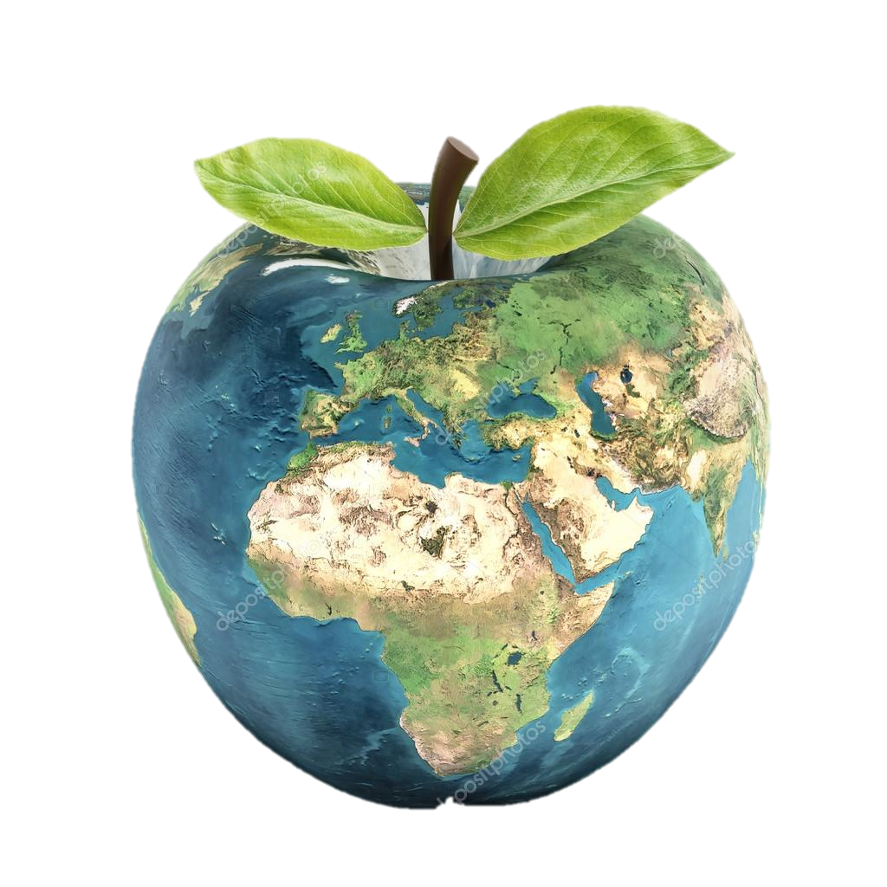
Apple Earth
Video
Notes:
https://www.youtube.com/watch?v=v9WXCAwk4_c

Slide 3
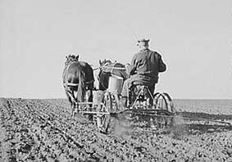
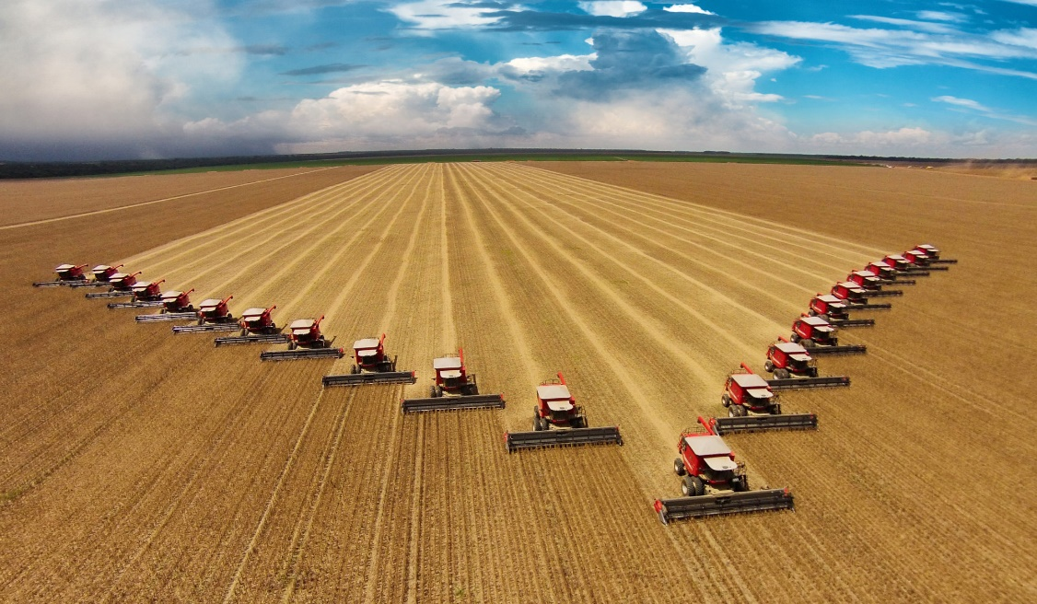
1920s vs Today

Slide 4
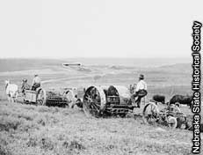
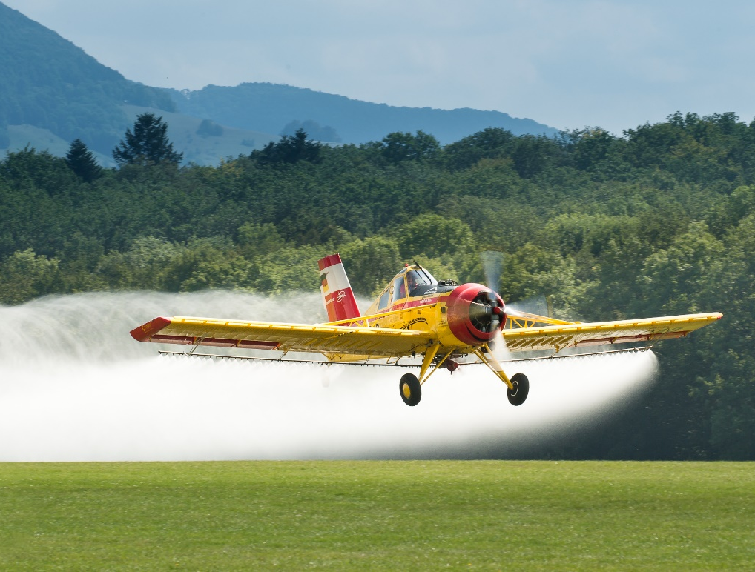
Pesticide & Fertilizer
1920s
Today

Slide 5
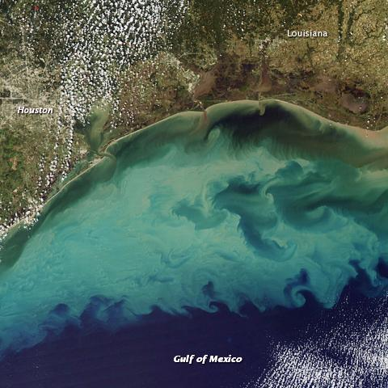
Environmental Consequences
Video
Notes:
https://www.youtube.com/watch?v=zeVVQmBkgiU

Slide 6
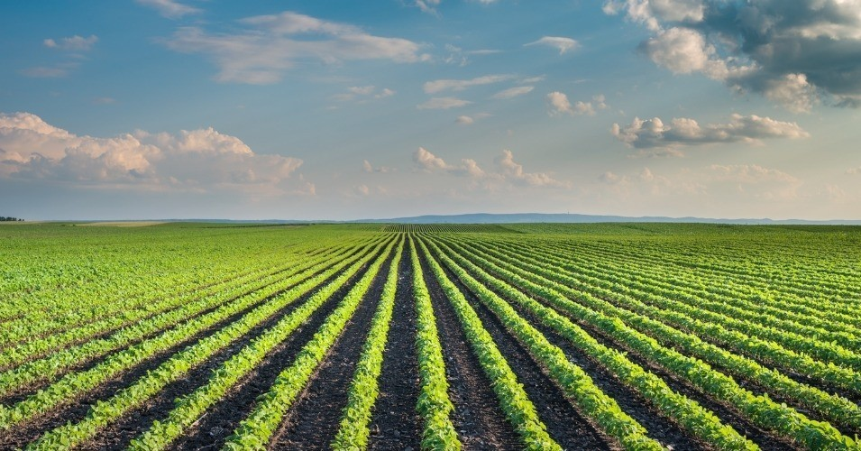
What Can We Do?

